Slide 1


YOUTH RISK BEHAVIOR SURVEY SUMMARY OF FINDINGS FOR 2024:
Concord-Carlisle Regional School District
Prepared For
Spring 2024

Slide 2
Table of Contents
Rationale, Objectives, and Methodology 3
Student Demographic Profile 7
Overall Summary of Findings 8
Detailed Findings 14
Trust & Belonging 15
Bullying, Cyberbullying, Threats, & Injury 23
Stress, Depression, & Suicide 31
Sexual Intercourse, Sexual Harassment, and Sexual Assault 40
Drugs & Alcohol 45
Unsafe Driving 52
Body Image & Dieting 56
Social Media & Cellphone Use 63
Lifestyle 76
Appendix 81
Appendix A: Changes to Questionnaire 82

Slide 3

Youth Risk Behavior Survey (YRBS)
2024 Emerson YRBS Overview
Since 1997, Emerson Hospital and public school districts within Emerson Hospital’s service area have collaborated to conduct the biannual Emerson Youth Risk Behavior Survey (YRBS). The YRBS is a comprehensive survey of students in 6th grade, 8th grade, and 9th through 12th grade on topics ranging from mental health and resiliency to technology habits, stress, body image, social media, bullying, substance use and sexual activity.
For more information, please contact:
Kelsey Magnuson
Community Benefits and Events Coordinator
Emerson Health
310 Baker Ave
Concord, MA 01742
978.287.1193
Concord-Carlisle Regional School District YRBS
Concord-Carlisle has participated in the Emerson YRBS since 2002 with the exception of 2021. This report presents findings for Concord-Carlisle Regional School District’s 6th graders, 8th graders, and high school students. Concord-Carlisle’s students from these grades are also included in the aggregate for all districts for 2024.

Slide 4




2024 Emerson YRBS Methodology
Students Participating in 2024 Emerson YRBS
Emerson YRBS strives to achieve a census of students in 6th grade, 8th grade, and high school. Ten public school districts participated in the 2024 survey, including 7,885 students in 6th grade, 8th grade and high school who completed an online survey in March, 2024.
Questionnaires are age-appropriate and based on the Massachusetts YRBS and U.S. Centers for Disease Control and Prevention versions.
Students participating in the Emerson YRBS are guaranteed confidentiality. Identifying information about students is not kept, and results are only reported in grouped form, with no way of identifying individuals.
Of the 1,677 students enrolled in Concord-Carlisle on March, 2024, 79% responded to the survey. The remaining students were either absent on the days the surveys were conducted, their parents/guardians opted for them not to participate, they submitted a blank survey (indicating refusal to participate), or the survey was not administered due to some technical challenges.
 | Total | 6th | 8th | High | Other
 | Surveyed | Grade | Grade | School
2024 TOTAL: | 7,885 | 1,415 | 1,537 | 4,890 | 12
Acton-Boxborough Regional School District | 2,213 | 366 | 394 | 1,450 | 3
Ayer Shirley Regional School District | 198 | 106 | 91 | 0 | 1
Bedford Public Schools | 1,005 | 198 | 177 | 629 | 1
Concord-Carlisle High School/Concord Public Schools | 1,327 | 179 | 187 | 960 | 1
Carlisle Middle School/Carlisle Public Schools | 113 | 59 | 53 | 0 | 1
Groton-Dunstable Regional School District | 749 | 148 | 142 | 457 | 2
The Bromfield School (Harvard Public Schools) | 426 | 82 | 80 | 264 | 0
Littleton High School/Littleton Public Schools | 429 | 0 | 115 | 313 | 1
Maynard Public Schools | 413 | 77 | 83 | 253 | 0
Nashoba Regional School District | 982 | 200 | 215 | 564 | 3
Throughout this report, “students” refers to Concord-Carlisle students unless otherwise specified (i.e., labeled “aggregate”).

Slide 5
Comparing 2024 and Previous Results for Emerson YRBS
Historical Comparisons
Companion Document
In this report, we compare 2020, 2022 and 2024 results for 6th graders, 8th graders, and high school students. We also include an aggregate for all districts combined for 2024, and Concord-Carlisle’s students are represented in the aggregate.
Along with this report, your district has received data tables in Excel format that include:
Comparable totals for 2020, 2021, 2022, 2024
Breakdowns by grade for 2020, 2021, 2022, 2024
Breakdowns for 2024 by selected student characteristics (gender, sexual orientation, race/ethnicity)
Census vs. Sample: What is the YRBS?
A census is a survey that includes everyone in the population being surveyed (e.g., all 6th or 12th grade youth). A sample surveys some members of the population, but not everyone.
Emerson YRBS is designed to be as close to a census of 6th grade, 8th grade, and high school youth as possible. There are, however, some youth who did not participate in the survey, so technically, the YRBS is a sample.
Because the Emerson YRBS sample is so large, however, nearly all differences (including small differences) will register in statistical software as statistically “significant.” This does not necessarily mean all changes are meaningful.
Questions
In this report, questions are referred to by number, e.g., “Q23” refers to Question 23 in the survey. Question numbers and exact question wording are also cross-referenced in the companion documents.
How to Gauge Whether a Difference is Meaningful in the Emerson YRBS
Statistically significant differences which also seem meaningful will be highlighted in red.

Slide 6
Previous Participation by School Districts
 | 2020 (pre-COVID) | 2021 | 2022 | 2024
Acton-Boxborough | ☑ | ☑ | ☑ | ☑
Ayer-Shirley | - | - | ☑ | ☑
Bedford |  | - | ☑ | ☑
Carlisle Middle School | ☑ | - | ☑ | ☑
Concord-Carlisle | ☑ | - | ☑ | ☑
Groton-Dunstable | ☑ | ☑ | ☑ | ☑
Harvard Bromfield | ☑ | - | ☑ | ☑
Littleton | ☑ | - | ☑ | ☑
Maynard | ☑ | ☑ | ☑ | ☑
Nashoba | ☑ | - | ☑ | ☑
Question numbers are included at the bottom of the slides throughout this report, to show the number, text, and years the question was asked of students.
Question #
Question Text
Years Question Was Asked
Q38 | During the past 12 months have YOU repeatedly threatened, humiliated, or harassed (bullied) someone in school? | 2020 |  | 2022 | 2024

Slide 7
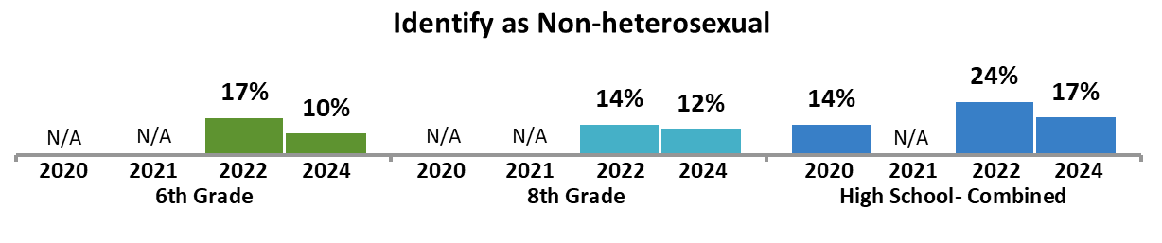
Student Demographic Profile
2024 | 6TH Grade | 8th Grade | High School
Gender (Q3)*
Female | 47% | 42% | 46%
Male | 51% | 56% | 51%
Non-binary | 2% | 2% | 3%
Transgender (Q4)
Yes | 4% | 3% | 4%
No | 94% | 94% | 94%
Not sure | 2% | 3% | 2%
Sexual Orientation (Q5)
Straight (heterosexual) | 80% | 84% | 78%
Gay or lesbian (homosexual) | 2% | 3% | 3%
Bisexual | 6% | 7% | 10%
Another orientation (asexual, pansexual etc.) | 2% | 3% | 4%
Not sure | 10% | 4% | 4%
Race/Ethnicity- Select as many as apply (Q15-22)*
American Indian or Alaska Native | 3% | 1% | 1%
Asian American | 11% | 11% | 15%
Black or African American | 10% | 10% | 7%
Hispanic or Latino/Latina/Latinx/Latine | 8% | 10% | 8%
Middle Eastern American | 3% | 4% | 4%
Native Hawaiian or Pacific Islander | 0% | 1% | 1%
Southeast Asian American | 1% | 1% | 1%
White | 75% | 78% | 82%
Don’t Know | 4% | 1% | 1%
The proportion of students who identify as non-heterosexual appears to decrease slightly among all grades between 2022 and 2024, significantly so among high school students.

Slide 8
Overall Summary of Findings

Slide 9

Compared to 2022, students show an increase in some positive attitudes and experiences, though rates of certain risk factors have also increased.
While rates of being bullied increased, so to have rates for confidence in adults to help and feeling supported by adults at school compared to 2022.
Positive behaviors and attitudes that demonstrate
an overall increase compared to previous years
Negative behaviors and experiences that display
an overall increase compared to previous years
Feeling safe with family
Trending up among all students since 2022.
Confidence in adults to help with bullying
Showed a substantial increase among 6th grade students and is trending up among older students since 2022.
Feeling supported by adults at school
Increase among 6th grade and high school students since 2022.
Being bullied
Increase among middle school students and is trending up for high school students since 2022.
Sending or receiving explicit media
Increased among 8th grade and high school students and is trending up for 6th graders since 2022.
Viewing explicit media/pornographic materials
Increased among all grades, though changes in question wording may account for much of this increase.
*Throughout this report, “students” refers to Concord-Carlisle students unless otherwise specified (i.e., labeled “aggregate”).

Slide 10

Many risky experiences and attitudes have decreased compared to prior years, including sexual harassment and e-cigarette use at school.
Rates of feeling depressed and self-harm have decreased overall. However:
Students with certain identities display disproportionate rates of feeling depressed or self-harm.
Those who feel depressed or consider suicide demonstrate a greater likelihood of engaging in a variety of other risk behaviors and attitudes.
Risk behaviors and attitudes that have
decreased compared to previous years
Those who feel depressed are at a greater risk in other ways, including:
Get 5 hours of sleep or less on average (56%)
Self-harm (46%) or consider suicide (32%)
Not feel adults at school can help with bullying (34%)
Be bullied (31%) or cyberbullied (20%)
Recently drink alcohol (23%)
Engage in unhealthy dieting (19%)
Feeling depressed
Decreased among 8th grade and high school students between 2022 and 2024.
Engaging in self-harm
Decreased among all grades in 2024 compared to 2022.
Sexual harassment
Decreased among high school students and is trending down for 8th grade students since 2022.
E-cigarette use at school
Decreased among 6th grade and high school students and is trending down among 8th graders since 2022.
Having a hard time leaving uncomfortable chats online
Decreased among 8th grade and high school students since 2022.
Similarly, those who self-harm are also likely to:
Be depressed (51%) or consider suicide (32%)
Not feel adults at school can help with bullying (29%)
Be bullied (26%) or cyberbullied (16%)
Recently drink alcohol (23%)
Engage in unhealthy dieting (20%)

Slide 11


While overall rates of many risky behaviors have decreased over time, as students mature, they show a tendency to engage in certain risky experiences and behaviors.
As can be expected, there are stark differences in risky behaviors based on grade, with younger and older students dealing with different problems and finding different ways to cope.
Compared to lower grade levels, high school students appear more likely to engage in several risky experiences or behaviors, including:
Parents not monitoring phone or social media use
Drinking alcohol
Feeling their weight influences how they judge themselves
Using e-cigarettes or marijuana
Having sexual intercourse
Sending or receiving explicit materials
Sleeping less than 7 hours on average each night
Additionally, these students indicate being under more stress from their academic workload
Compared to students in higher grade levels, those in the 6th grade appear more likely to struggle with:
Being bullied at school
Missing school days due to safety concerns
Feeling depressed
Experiencing difficulty leaving uncomfortable online chats
Not feeling supported by adults at school
However, 6th graders also appear to have more protection against certain risks including:
Lower levels of stress due to academic workload
Greater likelihood of trying to help other students being bullied
Following the rules their parents set regarding social media use

Slide 12






Students who identify as transgender, non-binary, or non-heterosexual are especially vulnerable.
Among other risk factors, those with non-traditional gender identities or sexual orientation are at an increased likelihood to:
This slide only shows information from the aggregate sample, as Ns for certain racial and ethnic groups are small within the Concord-Carlisle district and may not be generalizable.
Not feel as if they belong at school
Be bullied
Be sexually harassed
Be depressed
Self-harm
Consider suicide
22% of transgender students
22% of non-binary students
17% of non-heterosexual students
28% of transgender students
28% of non-binary students
21% of non-heterosexual students
Students who identify as transgender, non-binary, or non-heterosexual show a disproportionate rate of incidence for several risk factors.
Notably, especially high proportions of these students indicate recently feeling depressed or engaging in self-harm.
Most concerningly, just under a quarter of students who identify as transgender or non-binary also indicate having considered suicide at some point in the last 12 months.
These students who identify as non-binary or transgender are more than twice as likely to not know where to go or who to talk to if they had a serious problem, indicating that many suffer in silence.
27% of transgender students
28% of non-binary students
26% of non-heterosexual students
40% of transgender students
38% of non-binary students
35% of non-heterosexual students
35% of transgender students
42% of non-binary students
33% of non-heterosexual students
23% of transgender students
24% of non-binary students
19% of non-heterosexual students

Slide 13

Certain racial and ethnic groups also have an increased incidence of several risk factors or behaviors.
Due to structural racism and other forms of systemic bias, certain racial and ethnic groups display an increased likelihood of substance use and other risks, including:
This slide only shows information from the aggregate sample, as Ns for certain racial and ethnic groups are small within the Concord-Carlisle district and may not be generalizable.
Not feeling like they belong at school
Being bullied
Bullying others
Being depressed
Self-harm
26% of Native Hawaiian/Pacific Islander students
16% of Black/African American students
33% of Native Hawaiian/Pacific Islander students
24% of Middle Eastern American students
23% of Black/African American students
While a variety of racial or ethnic groups show higher rates of risk factors and behaviors, this appears to be especially prevalent with Native Hawaiian or Pacific Islander students.
Many of these groups also have greater rates of not having a trusted adult at school to talk to and not being willing to seek out an adult when they have a serious problem.
Given this, consider placing substantial efforts towards ensuring non-white students feel as though they belong and are supported.
23% of Native Hawaiian/Pacific Islander students
10% of Middle Eastern American students
30% of Southeast Asian American students
26% of Native Hawaiian/Pacific Islander students
25% of Hispanic or Latinx students
32% of Native Hawaiian/Pacific Islander students
21% of Southeast Asian American students
19% of American/Indian/Alaska Native students

Slide 14
Detailed Findings

Slide 15
Trust and Belonging

Slide 16
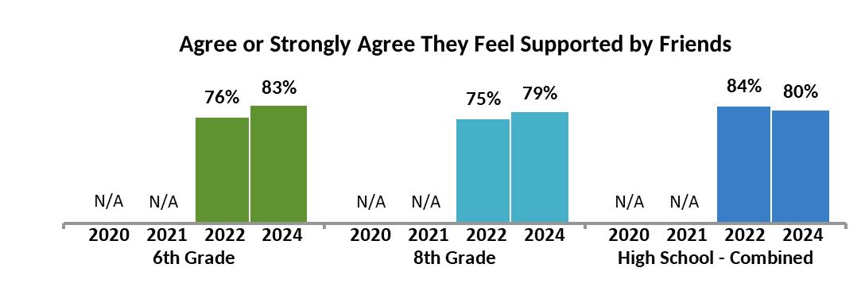
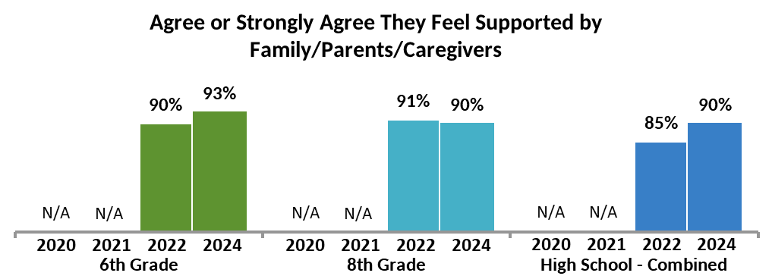
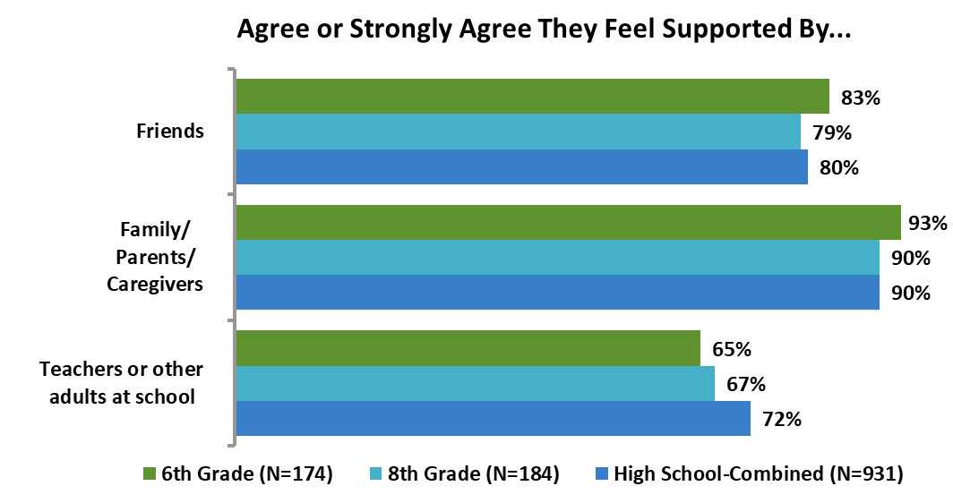
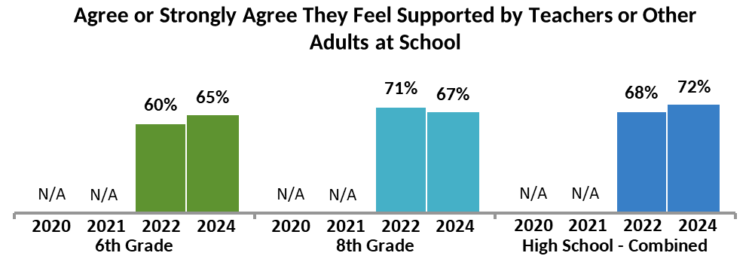
Sources of Support
As grade level increases, the proportion of students who feel supported by adults at school also increases.
Among 6th grade students, the proportion who agree they feel supported by friends, family, or teachers appears to be trending up since 2022.
Rates of feeling supported by family have increased among high school students over time.
Q27, Q28, Q29 | I feel Supported by …my friends, …my family/parents/caregivers, …my teachers and other adults at school. |  |  | 2022 | 2024

Slide 17
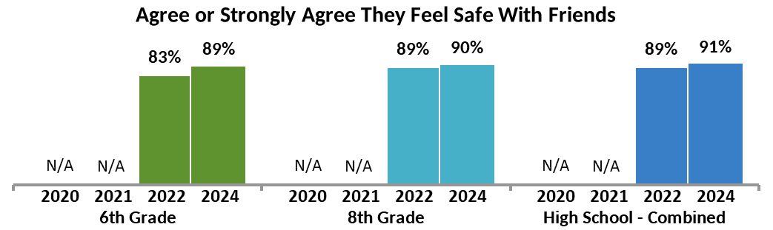
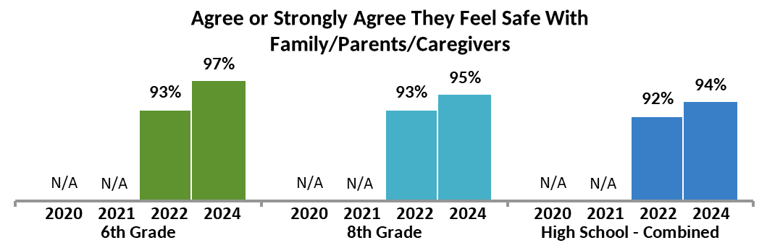
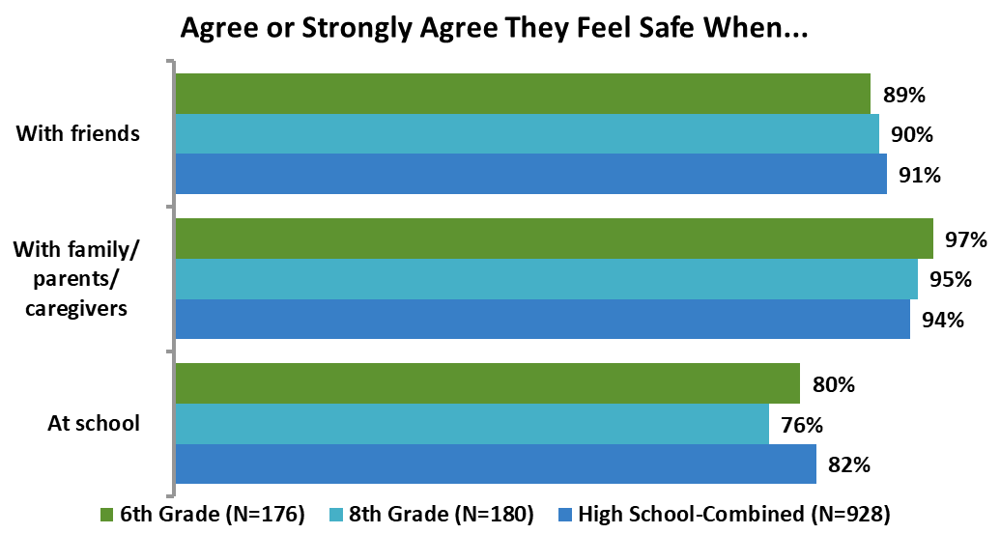
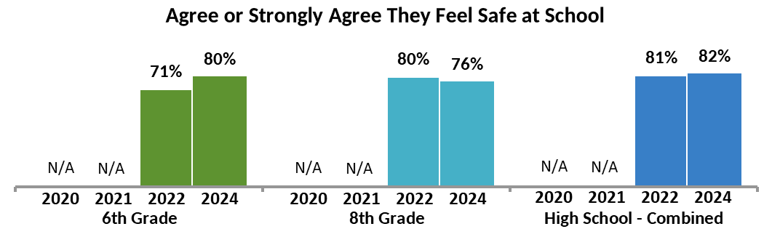
Sources of Safety
Rates of feeling safe with family or caregivers, with friends, or at school are trending up among 6th grade students between 2022 and 2024.
High school students show somewhat higher rates of feeling safe at school compared to younger students.
On the other hand, 6th grade students show somewhat higher rates of feeling safe with family or caregivers compared to older students.
Q31, Q32, Q33 | I feel safe when I am …with friends, …with my family/parents/caregivers,… at school. |  |  | 2022 | 2024

Slide 18
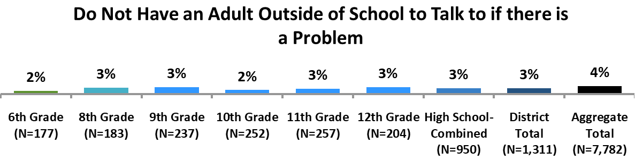
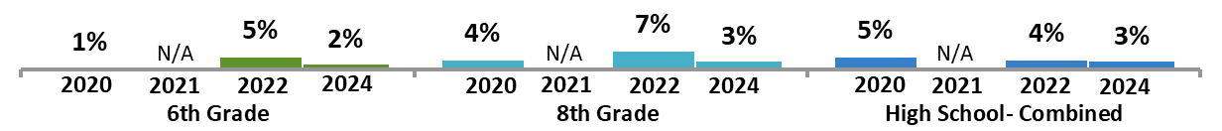
Trusted Adults Outside of School
Overall, 93% of students feel they have an adult outside of school that they can talk to if experiencing a problem.
The proportion of those who feel they do not have a trusted adult is low and appears to be trending down among high schoolers compared to 2022.
In the aggregate sample, those who do not have an adult outside of school have an increased incidence of depression, self-harm, and suicide consideration.
Additionally, half of those who report not having an adult outside of school to talk to also report not having an adult or teacher at school to talk to.
Aggregate Demographics and Behaviors Associated with Not Having a Trusted Adult Outside of School
(4% of the population)
Demographics
18% of those who identify as Native Hawaiian or Pacific Islander
12% of those who identify as Southeast Asian American
10% of those who identify as American Indian or Alaska Native
10% of those who identify as transgender
7% of those who identify as non-binary
Those lacking a trusted adult outside of school are also likely to:
Not have a trusted adult or teacher at school (50%)
View pornography (40%)
Feel depressed (39%), self-harm (32%), or consider suicide (25%)
Be sexually harassed (26%)
Have been bullied (25%) or cyberbullied (19%)
Send or receive sexual messages (22%)
Engage in unhealthy dieting (19%)
Have sexual intercourse (16%)
Bully (10%) or cyberbully others (8%)
Use e-cigarettes (7%)
Additionally, 6% of 6th graders, 4% of 8th graders, and 5% of high schoolers in 2024 were not sure if they had an adult outside of school they could talk to.
Q25 | Is there at least one adult in your life outside of school that you could talk to if you had a problem? | 2020 | 2021 | 2022 | 2024

Slide 19
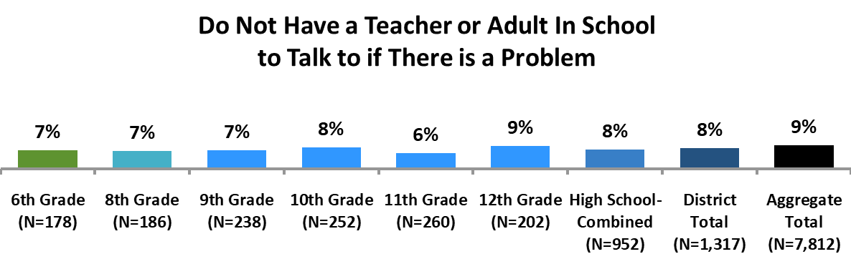
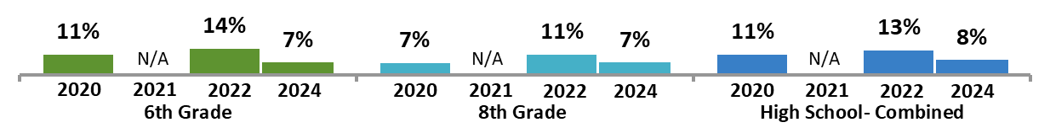
Trusted Adults at School
Overall, just over 4 in 5 students (82%) feel they have a teacher or adult at school they can talk to if they are experiencing a problem.
The proportion of those who do not is small and has decreased since 2022 for all grade levels, significantly so among high schoolers.
In the aggregate sample, just over 1 in 5 (21%) of those who do not have a teacher or adult to talk to at school also indicate not having an adult outside of school.
Aggregate Demographics and Behaviors Associated with Not Having a Trusted Teacher or Adult at School
(9% of the population)
Demographics
19% of those who identify as Native Hawaiian or Pacific Islander
17% of those who identify as Southeast Asian American
15% of those who identify as American Indian or Alaska native
11% of those who identify as transgender
Those who don’t have a teacher or adult at school are also more likely to:
View pornography (36%)
Feel depressed (23%), self-harm (20%), or consider suicide (12%)
Not have a trusted adult outside of school (21%)
Have been bullied (18%) or cyberbullied (14%)
Send or receive sexual messages (17%)
Be sexually harassed (16%)
Additionally, 17% of 6th graders, 11% of 8th graders, and 9% of high schoolers in 2024 were not sure if they had a teacher or adult at school to talk to.
Q23 | Is there at least one teacher or other adult in your school that you could talk to if you had a problem? | 2020 | 2021 | 2022 | 2024

Slide 20
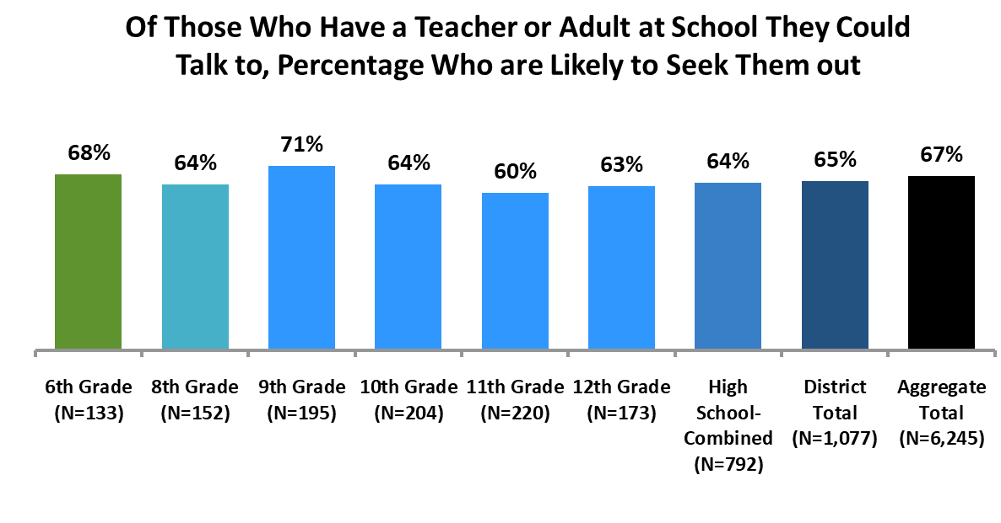
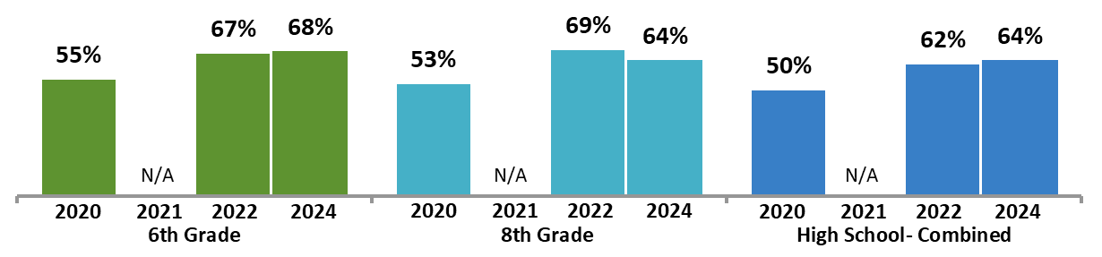
Seeking Out Adults at School
All grades are more likely to seek out an adult at school for help compared to 2020.
Q24 | When you have an issue or problem you need help with how likely are you to seek out a teacher or other adult at school for help? | 2020 | 2021 | 2022 | 2024

Slide 21
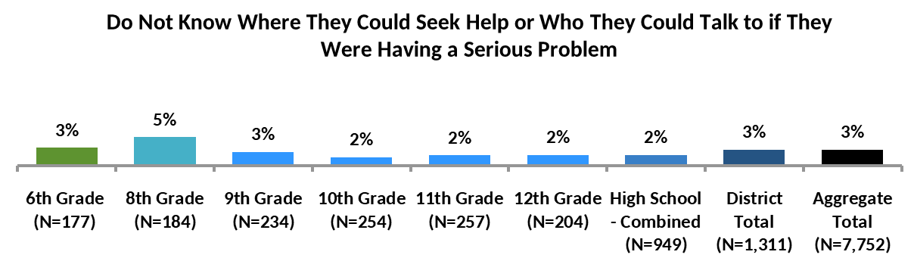
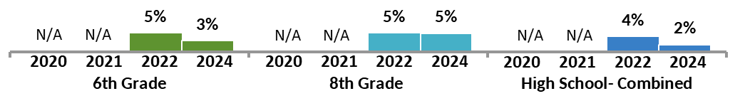
Resources for Help
Overall, 91% of students feel they know where to seek help or who to talk to if they had a serious issue.
Rates of not knowing where to go or who to talk to appear highest in 8th grade.
In the aggregate sample, those who identify as Native Hawaiian or Pacific Islander are less likely to have a place or person to seek out or talk to.
Those without this resource are more likely to experience depression, self-harm, or consider suicide.
Aggregate Demographics and Behaviors Associated with Not Knowing Where to go if Having a Serious Problem
(3% of the population)
Demographics
19% of those who identify as Native Hawaiian or Pacific Islander
11% of those who identify as Southeast Asian American
10% of those who identify as American Indian or Alaska Native
8% of those who identify as non-binary
8% of those who identify as transgender
Those who don’t have a place or person to seek help from are also more likely to:
Not have a trusted adult at school (49%)
Not have a trusted adult outside of school (41%)
Feel depressed (38%), self-harm (34%), or consider suicide (24%)
View pornography (38%)
Have been bullied (32%) or cyberbullied (24%)
Send or receive sexual messages (23%)
Bully (11%) or cyberbully others (10%)
Use e-cigarette products (6%) or marijuana (7%)
Additionally, 8% of 6th graders, 6% of 8th graders, and 5% of high schoolers in 2024 were not sure if they knew where to seek help.
Q26 | If you were having a serious problem and needed help, do you know where you could seek help or who you could talk to? |  |  | 2022 | 2024

Slide 22
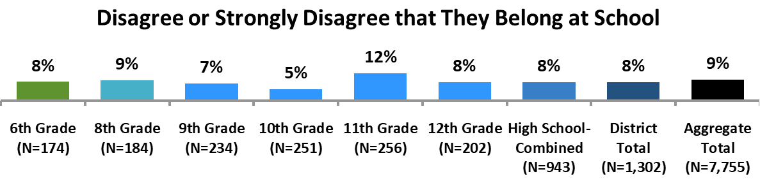
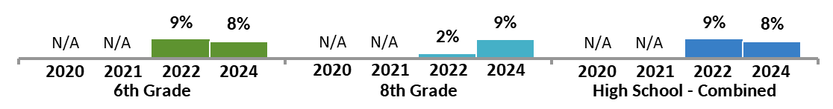
Sense of Belonging at School
While just over 2 in 3 students (69%) agree or strongly agree that they belong in school, the feeling of not belonging appears especially high in 11th grade. The proportion of 8th graders who feel as if they don’t belong has increased significantly.
In the aggregate sample, an especially high percentage of students who identify as transgender, non-binary or Native Hawaiian or Pacific Islander feel as if they don’t belong at school.
While feeling as if one does not belong at school is associated with many risk factors, depression, self-harm, and suicide consideration are especially high for these students.
Aggregate Demographics and Behaviors Associated with Not Feeling as if One Belongs at School
(9% of the population)
Demographics
26% of those who identify as Native Hawaiian or Pacific Islander
22% of those who identify as non-binary
22% of those who identify as transgender
17% of those who identify as non-heterosexual
16% of those who identify as Black or African American
Those who feel they don’t belong at school are also more likely to:
View pornography (44%)
Feel depressed (42%), self-harm (34%), or consider suicide (27%)
Have been bullied (38%) or cyberbullied (21%)
Send or receive sexual messages (26%)
Have sexual intercourse (16%)
Drink alcohol (14%)
Bully (9%) or cyberbully others (7%)
Use marijuana (9%)
Q30 | I feel I belong at my school |  |  | 2022 | 2024

Slide 23
Bullying, Cyberbullying, Threats, and Injury

Slide 24
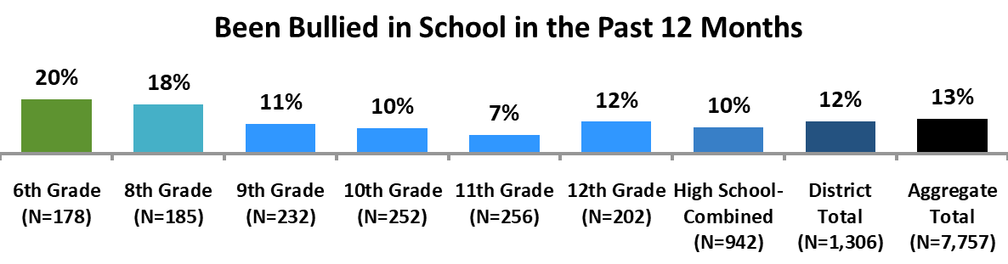
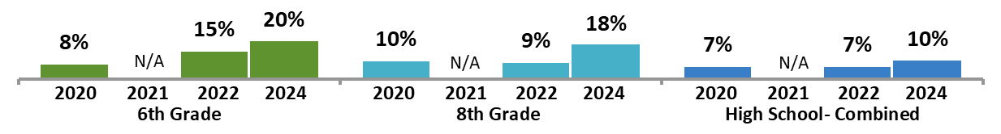
Being Bullied
Rates of being bullied are highest among 6th and 8th graders.
Furthermore, rates of bullying have increased among 6th and 8th graders between 2020 and 2024 and may be trending upwards among high school students.
In the aggregate sample, nearly a third of students who identify as transgender or non-binary report being bullied.
Students who identify as a race or ethnicity other than white or Asian American also report being bullied at a higher rate than their white or Asian American classmates.
Aggregate Demographics and Behaviors Associated with Being Bullied
(13% of the population)
Demographics
33% of those who identify as Native Hawaiian or Pacific Islander
28% of those who identify as non-binary
28% of those who identify as transgender
24% of those who identify as Middle Eastern American
23% of those who identify as Black or African American
Those who are bullied at school are also more likely to:
View pornography (50%)
Be cyberbullied (40%)
Feel depressed (36%), self-harm (30%), or consider suicide (20%)
Be sexually harassed (30%)
Send or receive sexual messages (27%)
Bully (17%) or cyberbully others (12%)
Drink alcohol (15%)
Have sexual intercourse (15%)
Use e-cigarettes (8%) or marijuana (9%)
Q37 | During the past 12 months have you been repeatedly threatened, humiliated, or experienced hostile behaviors (bullied) from others in school? | 2020 |  | 2022 | 2024

Slide 25
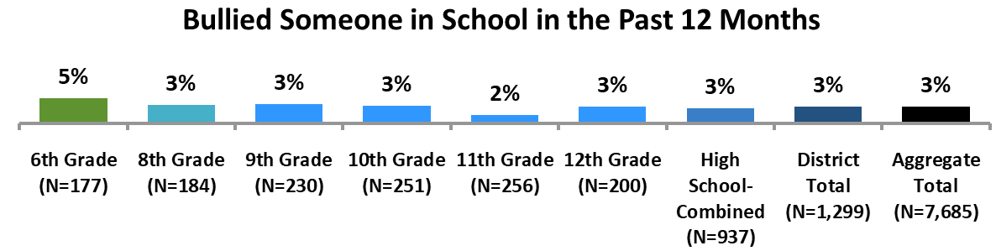
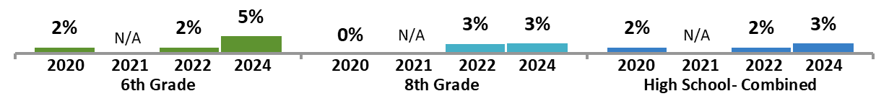
Bullying Others at School
Rates of bullying others appear low across all grades.
Rates among 8th grade and high school students are low and remain largely stable over time.
In the aggregate sample, a large proportion of those who bully others also report being bullied or cyberbullied by others, indicating that bullying and being bullied are often linked.
Furthermore, over half of those who bully others doubt that adults at school can help if they are being bullied or harassed, which may be leading them to “take matters into their own hands” so to speak.
Aggregate Demographics and Behaviors Associated with Bullying Others
(3% of the population)
Demographics
23% of those who identify as Native Hawaiian or Pacific Islander
10% of those who identify as Middle Eastern American
9% of those who identify as Black or African American
9% of those who identify as American Indian or Alaska Native
9% of those who identify as transgender
7% of those who identify as non-binary
Those who have bullied someone at school are also more likely to:
Have been bullied (73%) or cyberbullied (51%)
View pornography (59%)
Don’t think adults at school can help if they are being bullied (56%)
Cyberbully others (42%)
Send or receive sexual messages (37%)
Feel depressed (36%), self-harm (31%), or consider suicide (22%)
Be sexually harassed (35%)
Drink alcohol (29%)
Have sexual intercourse (25%)
Use e-cigarettes (17%) or marijuana (21%)
Q38 | During the past 12 months have YOU repeatedly threatened humiliated or harassed (bullied) someone in school? | 2020 |  | 2022 | 2024

Slide 26
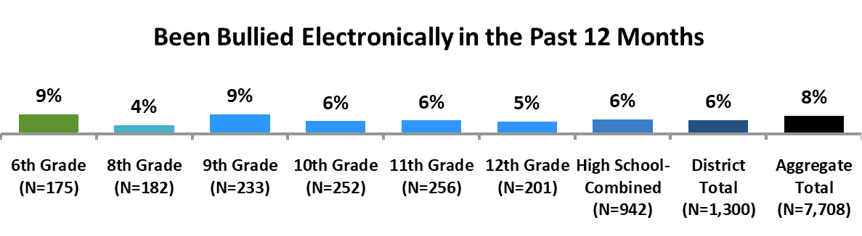
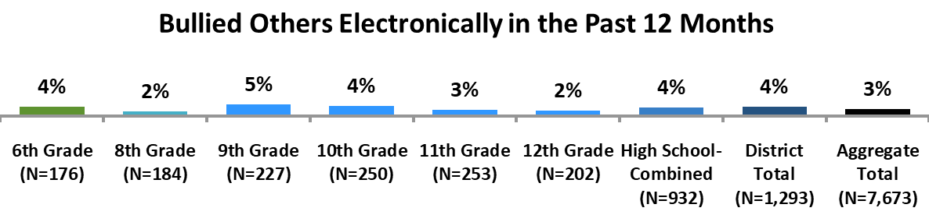
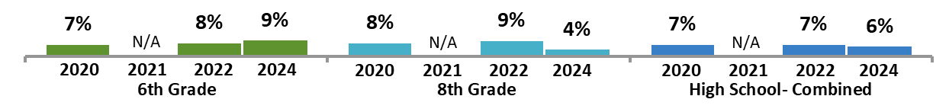
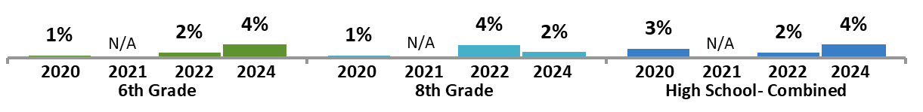
Cyberbullying
Rates of being cyberbullied are lower than rates of being bullied at school.
2 in 3 students (66%) who report being cyberbullied, also indicate that they are bullied at school.
Rates of cyber bullying remain somewhat low over time and may be trending down among 8th grade students since 2022.
Very few students admit to cyberbullying others, and these rates have remained low over time.
Nearly half of students who cyberbully also bully others at school (49%).
2 in 5 students (40%) who cyberbully also have social media accounts their parents don’t know about.
Q39 | During the past 12 months have you been repeatedly threatened humiliated or experienced hostile behaviors (bullied) from others electronically? | 2020 | 2021 | 2022 | 2024
Q40 | During the past 12 months have YOU repeatedly threatened humiliated or harassed (bullied) someone electronically? | 2020 | 2021 | 2022 | 2024

Slide 27
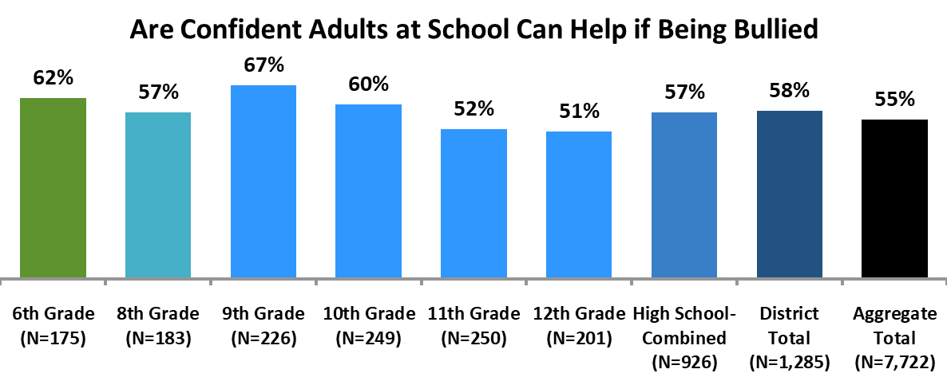
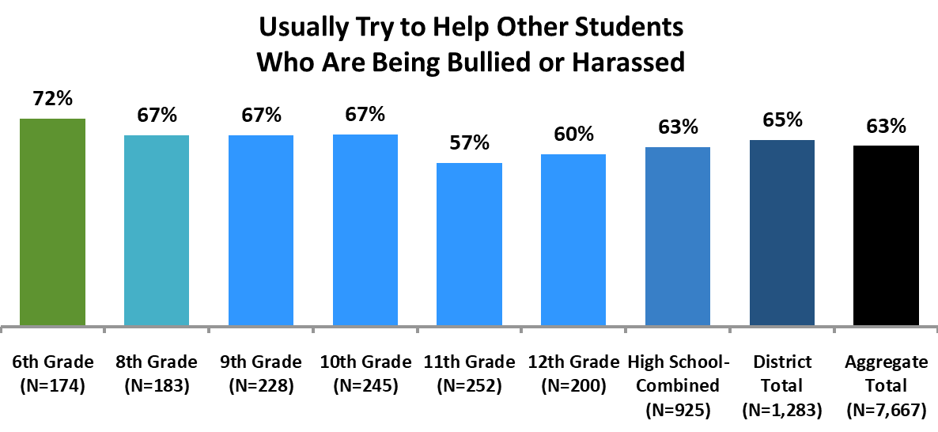
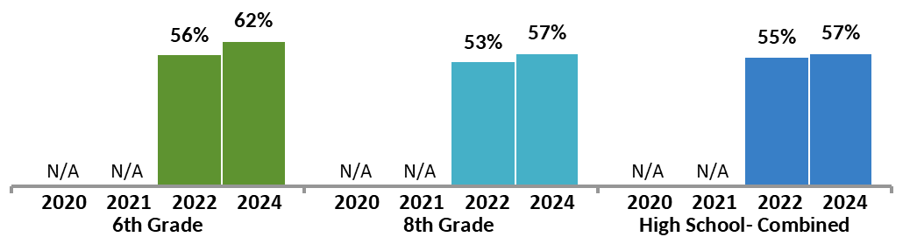
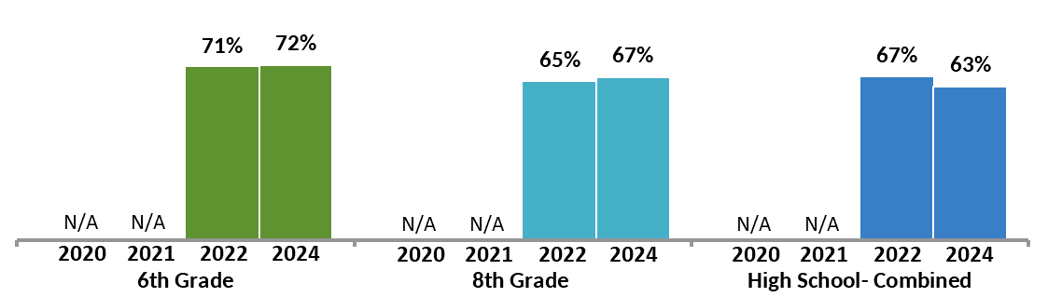
Coping with Bullying
Confidence in adults and teachers at school appears highest among 9th graders.
Confidence in adults at school appears to be trending up among all grades.
Rates of trying to help others who are being bullied or harassed appear highest in younger grades.
Compared to 2022, rates of trying to help others who are being bullied remained mostly stable.
Q34 | If I am being bullied or harassed, I am confident adults at school can help me. |  |  | 2022 | 2024
Q35 | I usually try to help other students who are being bullied or harassed. |  |  | 2022 | 2024

Slide 28
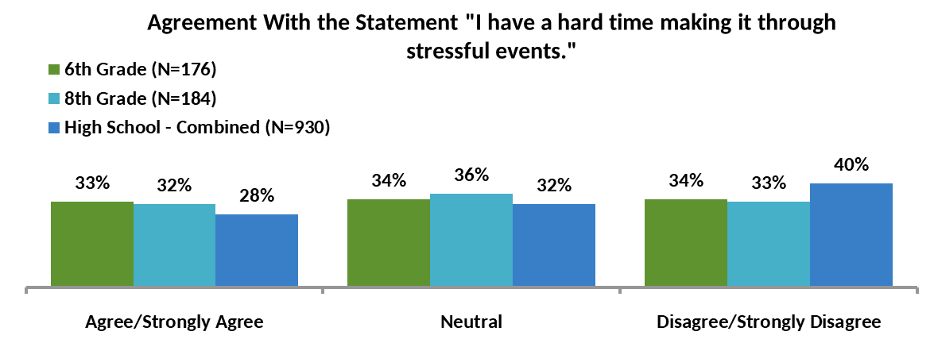
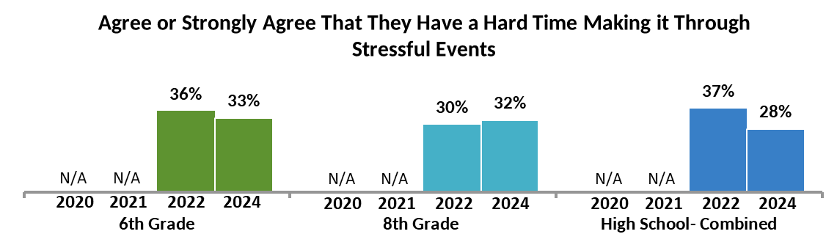
Handling Stressful Events
Aggregate Demographics and Behaviors Associated with Having a Hard Time Making it Through Stressful Events
(31% of the population)
Students are relatively evenly split on whether they agree, disagree, or feel neutral regarding the statement “I have a hard time making it through stressful events.”
Rates of agreement among high school students decreased between 2022 and 2024.
Demographics
53% of those who identify as non-binary
50% of those who identify as non-heterosexual
49% of those who identify as transgender or are not sure if they identify as transgender
37% of those who identify as female
35% of those who identify as Hispanic or Latino/Latina/Latinx/Latine
Those who have a hard time navigating stress are also more likely to:
Feel somewhat or very high stress from school workload (73%)
Get 6 hours of sleep or less (42%)
Feel somewhat or very high stress from pressures at home (39%)
Feel depressed (28%), self-harm (20%), or consider suicide (12%)
Be bullied (19%)
Experience a risky/unwanted situation due to information they shared electronically (17%)
Engage in unhealthy dieting (13%)
Experience sexual assault (10%)
Not feel safe at school (8%)
Q36 | I have a hard time making it through stressful events. |  |  | 2022 | 2024

Slide 29
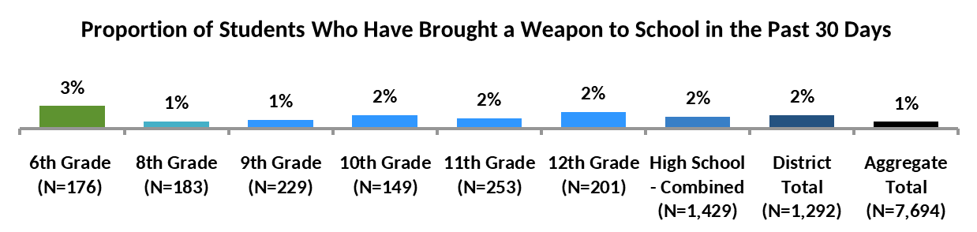
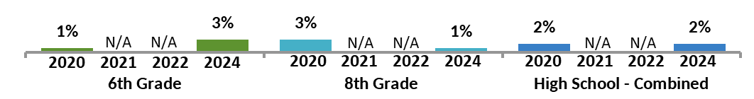
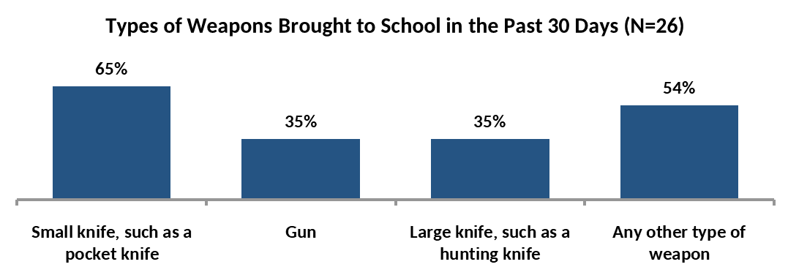
Weapons in School
While 2% of the students have brought a weapon to school in the last 30 days, 3% have brought a weapon to school at some point more than 30 days ago.
Of the 26 students who have brought a weapon to school in the past 30 days, most (17 students) brough a small knife, such as a pocketknife.
Rates of bringing a weapon to school have remained relatively stable over time.
Aggregate Demographics and Behaviors Associated with Intentionally Bringing a Weapon to School at any Point
(4% of the population)
Demographics
15% of those who identify as Native Hawaiian or Pacific Islander
13% of those who identify as non-binary students
10% of those who identify as transgender
10% of those who identify as Black or African American
Those who have brought a weapon to school are also more likely to:
Feel depressed (26%), self-harm (27%), or consider suicide (17%)
Be bullied (24%) or cyberbullied (20%)
Be sexually harassed (22%)
Not have a trusted adult to talk to at school (16%)
Be threatened or injured by someone with a weapon on school property (16%)
Not go to school due to feeling unsafe there (15%)
Not feel safe at school (14%) or with friends (10%)
Bully (13%) or cyberbully others (13%)
Not have a trusted adult outside of school to talk to (10%)
Q41-44 | During the past 30 days have you intentionally brought any of the following with you to school? Check all that apply: | 2020 |  |  | 2024

Slide 30
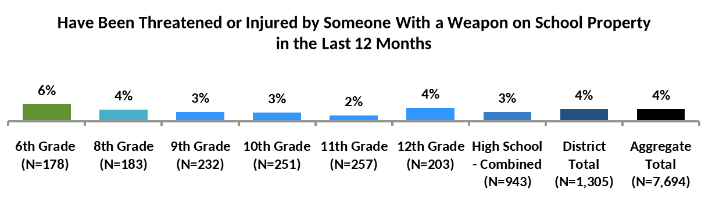
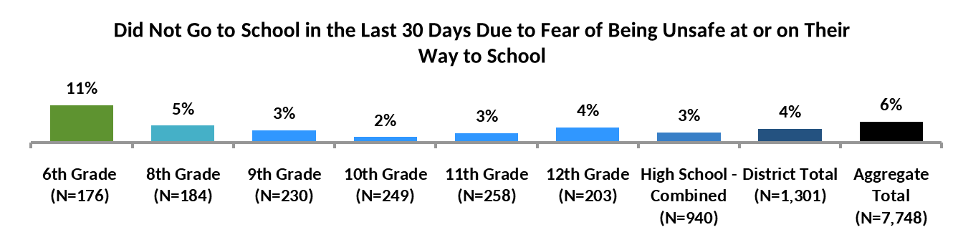
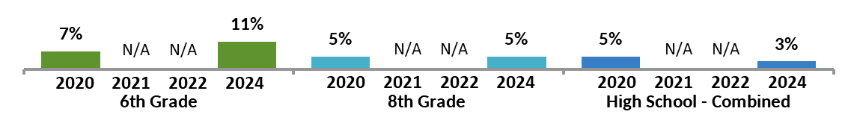
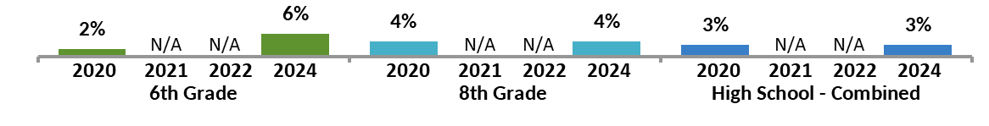
Threat, Injury, and Absence
Rates of being threatened or injured by someone with a weapon on school property are low across all grades but appear highest in 6th grade.
Rates of being threatened or injured may be trending up among 6th grade students.
Rates of missing 1 or more days of school in the 30 days leading up to the survey appear highest in 6th grade.
Since 2020, rates of not going to school due to fear of being unsafe have decreased among high school students.
Q45 | During the past 12 months how many times has someone threatened or injured you with a weapon such as a gun, knife, or club on school property? | 2020 |  |  | 2024
Q46 | During the past 30 days on how many days did you not go to school because you felt you would be unsafe at school or on your way to or from school? | 2020 |  |  | 2024

Slide 31
Stress, Depression, and Suicide

Slide 32
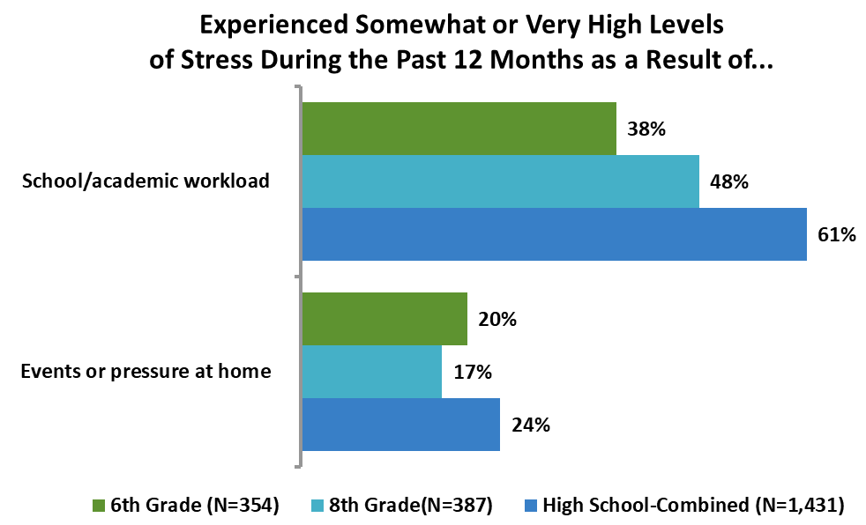
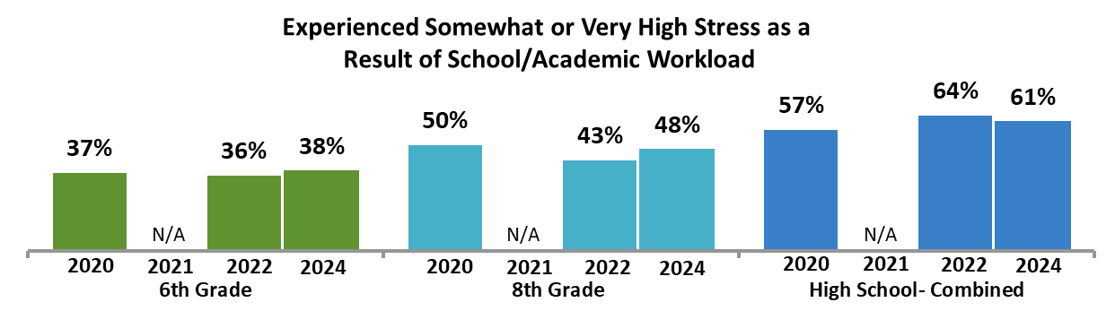
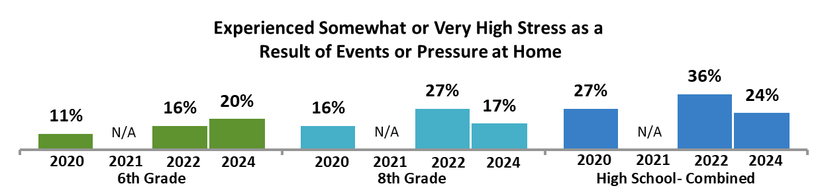
Sources of Stress
School/academic workload remains the largest source of stress among students.
This appears especially impactful with high school students, as just over 3 in 5 (61%) feel high levels of stress due to academic workload.
Stress from events or pressure at home decreased for 8th grade and high school students between 2022 and 2024. However, 6th grade students seem more likely to be experiencing stress from events or pressure at home compared to 2020.
Q55 | During the past 12 months what level of stress have you experienced as a result of your school/academic workload? | 2020 | 2021 | 2022 | 2024
Q56 | During the past 12 months what level of stress have you experienced as a result of events or pressure at home? |  | 2021 | 2022 | 2024

Slide 33
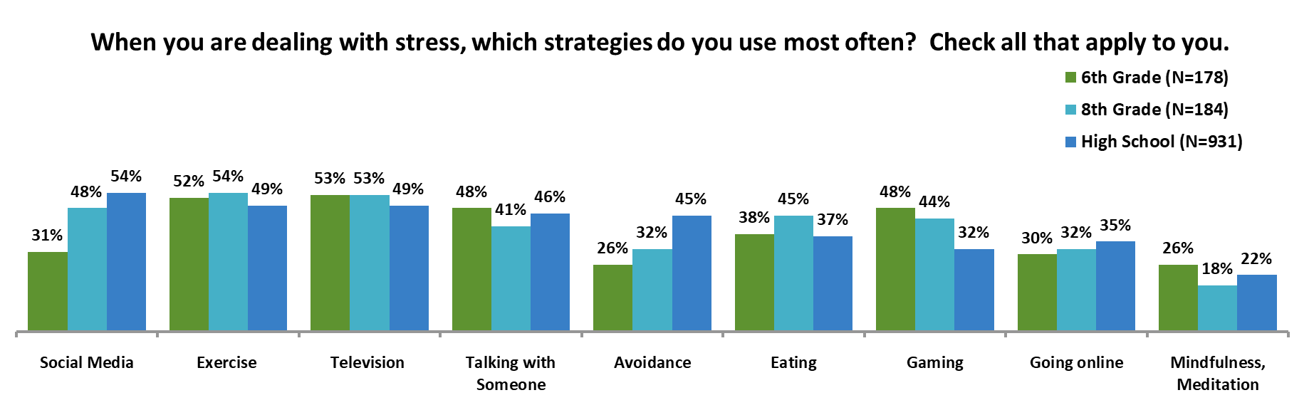
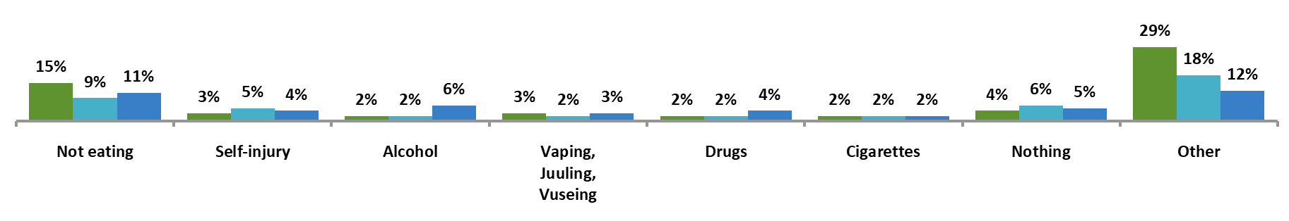
Coping Mechanisms
Overall, 9% of students report dealing with stress through drugs, alcohol, vaping, cigarettes, or self-harm.
Additionally, over 2 in 5 students (44%) cope with stress through either eating or avoiding food.
For high schoolers, the 3 most common ways to cope with stress are:
Social media
Exercise
Television
For 8th graders, the 3 most common ways to cope with stress are:
Exercise
Television
Social media
For 6th graders, the most common ways to cope with stress are:
Television
Exercise
Talking with someone
Gaming
* Note: Question changed in 2022, to include more coping behaviors.
Q57-72 | When you are dealing with stress which strategies do you use most often? Check all that apply to you. | 2020 | 2021 | 2022 | 2024

Slide 34
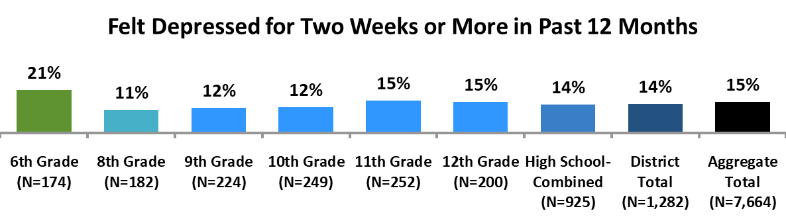
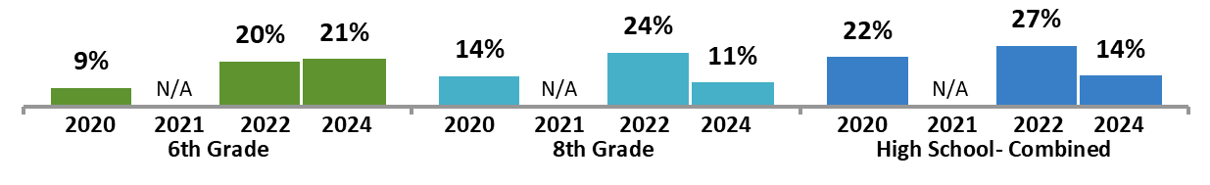
Depression
The proportion of 8th grade and high school students reporting depression has decreased in 2024 compared to 2022.
Rates of depression appear highest in 6th grade and in the last two years of high school.
In the aggregate sample, those with non-traditional gender identities or sexualities report feeling depressed over the past 12 months at especially high rates.
Students who are depressed are at risk for a variety of risk factors, especially self-harm and suicide consideration.
Aggregate Demographics and Behaviors Associated with Being Depressed
(15% of the population)
Demographics
40% of those who identify as transgender
38% of those who identify as non-binary
35% of those who identify as non-heterosexual
30% of those who identify as Southeast Asian American
26% of those who identify as Native Hawaiian or Pacific Islander
25% of those who identify as Hispanic, Latino/Latina/Latinx/Latine
18% of those who identify as female
Those who feel depressed are also more likely to:
Self-harm (43%) or consider suicide (35%)
Not feel that adults at school can help with bullying (34%)
Be sexually harassed (33%)
Be bullied (30%) or cyberbullied (21%)
Get 5 hours of sleep or less on average (26%)
Engage in unhealthy dieting (25%)
Drink alcohol (17%)
Have sexual intercourse (14%)
Use e-cigarettes (9%) or marijuana (11%)
Q74 | During the past 12 months did you ever feel so sad or hopeless almost every day for two weeks or more in a row that you stopped doing some usual activities? | 2020 | 2021 | 2022 | 2024

Slide 35
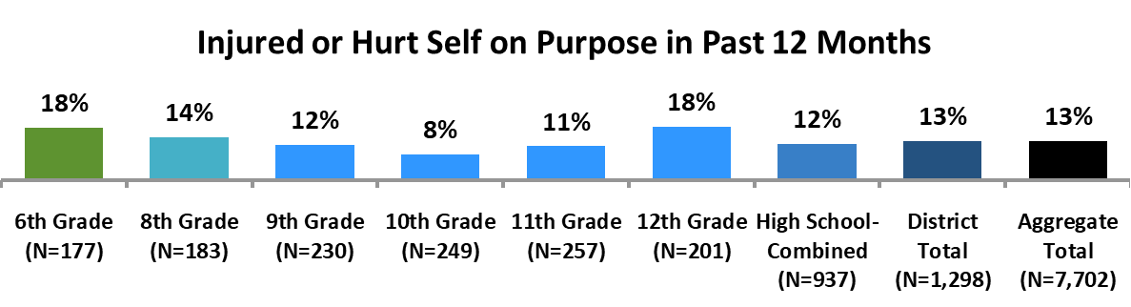
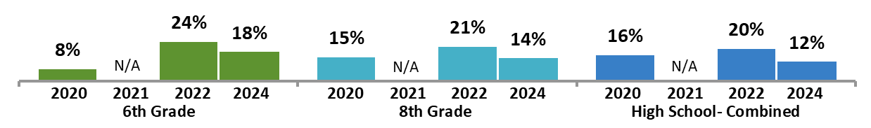
Self-harm
Rates of self-harm have decreased for 6th grade and high school students between 2022 and 2024 and appear to be trending down among 8th graders.
Those in the 6thand 12th grades appear most likely to engage in self-harm.
In the aggregate sample, students with a non-traditional gender or sexual orientation have especially high rates of self-harm.
Those who self-harm also display high rates of unhealthy eating, depression, and suicide consideration.
Aggregate Demographics and Behaviors Associated with Self-harm
(13% of the population)
Demographics
42% of those who identify as non-binary
35% of those who identify as transgender
33% of those who identify as non-heterosexual
32% of those who identify as Native Hawaiian or Pacific Islander
21% of those who identify as Southeast Asian American
Those who self-harm are also more likely to:
Be depressed (52%) or consider suicide (38%)
Not think adults at school can help with bullying (34%)
Be sexually harassed (32%)
Be bullied (31%) or cyberbullied (21%)
Engage in unhealthy dieting (25%)
Drink alcohol (16%)
Have sexual intercourse (13%)
Use e-cigarettes (9%) or marijuana (10%)
Q73 | During the past 12 months how many times did you hurt or injure yourself on purpose (for example by cutting burning or bruising yourself on purpose)? | 2020 | 2021 | 2022 | 2024

Slide 36

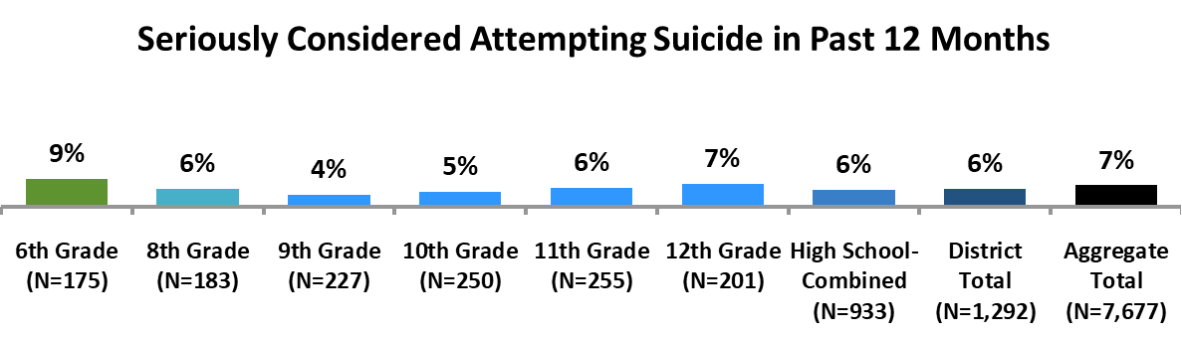

Suicide Consideration
Rates of suicide consideration decreased among high school students between 2020 and 2024 but increased among 6th graders in that timeframe.
In the aggregate sample, those who do not identify with a traditional gender or sexuality are especially likely to consider suicide.
Those who consider suicide also display high rates of depression, self-harm, and unhealthy dieting.
Aggregate Demographics and Behaviors Associated with Suicide Consideration
(7% of the population)
Demographics
24% of those who identify as non-binary
23% of those who identify as transgender
19% of those who identify as non-heterosexual
19% of those who identify as Native Hawaiian or Pacific Islander
Those who consider suicide are also more likely to:
Be depressed (79%) or self-harm (69%)
Do not think adults at school can help with bullying (41%)
Be bullied (38%) or cyberbullied (26%)
Be sexually harassed (38%)
Engage in unhealthy dieting (31%)
Drink alcohol (20%)
Have sexual intercourse (17%)
Use e-cigarettes (14%) or marijuana (14%)
Be threatened or injured with a weapon on school property (13%)
Q75 | During the past 12 months did you ever seriously consider attempting suicide? | 2020 | 2021 | 2022 | 2024

Slide 37




Suicide Planning and Attempts
Of those who seriously considered suicide (N=75), 55% made a suicide plan in the past year.
While Ns are small and may not be generalizable, rates of making suicide plans appear to have decreased for 6th graders since 2022.
Of those who made a suicide plan, over half (53%) went through with an attempt.
Just under 1 in 3 (30%) who made a suicide plan attempted suicide more than once.
While Ns are very small and may not be generalizable, rates of attempting suicide appear to have increased since 2022 among all grades.
*Note, Ns are small and may not represent trends in the population.
Q76 | During the past 12 months did you make a plan about how you would attempt suicide? | 2020 | 2021 | 2022 | 2024
Q77 | During the past 12 months how many times did you actually attempt suicide? | 2020 | 2021 | 2022 | 2024

Slide 38


Suicide Injury
Of the 24 students who made a suicide attempt, half needed medical treatment.
Note that Ns are small and may not be generalizable.
*Note, Ns are small and may not represent trends in the population.
Q78 | If you attempted suicide during the past 12 months did any attempt result in an injury poisoning or overdose that had to be treated by a doctor or nurse? | 2020 | 2021 | 2022 | 2024

Slide 39


Hearing About Suicide
Overall, 15% of students report someone they know telling them they were thinking about hurting themselves or were contemplating suicide.
The most common way students hear about suicide contemplation is through in-person conversation or over the phone.
The proportion of students hearing about suicide or self-harm attempts directly, from friends, or online has decreased for 6th grade and high school students between 2022 and 2024.
However, rates of hearing about someone thinking of self-harm or suicide appear to be trending up among 8th grade students between 2022 and 2024.
Q79 | In the past 12 months has anyone you know from school told you they were thinking about hurting themselves or suicide? |  | 2021 | 2022 | 2024

Slide 40
Sexual Intercourse, Sexual Harassment, and Sexual Assault

Slide 41


Sexual Intercourse
Rates of sexual intercourse increase alongside grade level within high school, with over a quarter (28%) of 12th graders engaging in sexual activity in the past 3 months.
Furthermore, 3% of students have had sexual intercourse with 3 or more people.
In the aggregate sample, those who have had sexual intercourse in the past 3 months are also more likely to engage in or experience other sexual risk behaviors or experiences such as sexual messaging, being sexually harassed, and pornography.
Aggregate Demographics and Behaviors Associated with Recent Sexual Intercourse
(9% of the population)
Demographics
26% of those who identify as Native Hawaiian or Pacific Islander
15% of those who identify as transgender
15% of those who identify as Black or African American
14% of those who identify as Hispanic or Latino/Latina/Latinx/Latine
14% of those who identify as Southeast Asian American
12% of those who identify as non-binary
Those who recently had sexual intercourse are also more likely to:
View pornography (61%)
Send or receive sexual messages (47%)
Drink alcohol (44%) or binge drink (40%)
Be sexually harassed (28%)
Be depressed (26%), self-harm (20%), or consider suicide (14%)
Be sexually assaulted (23%)
Be bullied (22%) or cyberbullied (17%)
Use e-cigarettes (21%) or marijuana (24%)
Engage in unhealthy dieting (20%)
Q92 | During the past 3 months with how many people did you have sexual intercourse? | 2020 | 2021 | 2022 | 2024

Slide 42


Sexual Harassment
Compared to 2022, rates of sexual harassment have decreased for high school students but have increased for 6th grade students.
Students indicate being sexually harassed in person slightly more than being sexually harassed online or in both settings (7%, 4%, and 4%, respectively).
In the aggregate sample, students who identify as transgender or non-heterosexual are much more likely to experience sexual harassment.
Sexually harassed students also show a greater likelihood of a variety of other risk factors, including feeling depressed and being bullied.
Aggregate Demographics and Behaviors Associated with Being Sexually Harassed
(12% of the population)
Demographics
33% of those who identify as Native Hawaiian or Pacific Islander
28% of those who identify as non-binary students
27% of those who identify as transgender
26% of those who identify as non-heterosexual
22% of those who identify as Middle Eastern
22% of those who identify as Southeast Asian American
18% of those who identify as female
Those who are sexually harassed are also more likely to:
View pornography (65%)
Send or receive sexual messages (42%)
Feel depressed (42%), self-harm (34%), or consider suicide (22%)
Be bullied (32%) or cyberbullied (25%)
Engage in unhealthy dieting (26%)
Drink alcohol (24%)
Have sexual intercourse (20%)
Bully (9%) or cyberbully others (8%)
* Note: Response options changed in 2021, to include sexual harassment online.
Q52 | During the past 12 months have you received unwelcome comments or actions of a sexual nature which made you uncomfortable (sexual harassment)? | 2020 | 2021 | 2022 | 2024

Slide 43


Nonconsensual Sexual Contact
Overall, 1% of students experienced nonconsensual sexual contact in the last 12 months.
Those in 12th grade are at least twice as likely to experience nonconsensual sexual contact as who are in 9th grade or middle school.
In the aggregate sample, just over 2 in 5 (41%) of those who have experienced nonconsensual sexual contact experienced it within the last 12 months or both within the past 12 months and more than 12 months ago.
Sexually assaulted students show a greater likelihood of a variety of risk factors, especially depression and self-harm.
Aggregate Demographics and Behaviors Associated with Experiencing Nonconsensual Sexual Contact
(6% of the population)
Demographics
21% of those who identify as non-binary students
19% of those who identify as transgender
18% of those who identify as Native Hawaiian or Pacific Islander
16% of those who identify as non-heterosexual
13% of those who identify as Southeast Asian American
8% of those who identify as female
Those who are sexually assaulted are also more likely to:
View pornography (69%)
Feel depressed (52%), self-harm (42%), or consider suicide (30%)
Send or receive sexual messages (48%)
Be bullied (39%) or cyberbullied (31%)
Have sexual intercourse (33%)
Drink alcohol (32%)
Engage in unhealthy dieting (32%)
Bully (11%) or cyberbully others (10%)
Q53 | During your life has anyone ever had sexual contact with you without your consent (e.g. molested, raped, or sexually violated)? | 2020 |  |  | 2024

Slide 44


Sexual Coercion and Harm When Dating
Aggregate Demographics and Behaviors Associated with Experiencing Harm or Sexual Coercion While Dating
(3% of the population)
Very few students indicate being harmed physically or sexually by a date or someone they are going out with.
However, while still low, rates among 6th grade students appear especially high and have increased in 2024 compared to 2020.
In the aggregate sample, students who have experienced coercion or being hurt by a date or long-term partner show a greater likelihood of a variety of other risk factors, including feeling depressed, self-harm, and drinking alcohol.
Demographics
13% of those who identify as Native Hawaiian or Pacific Islander
9% of those who identify as transgender
8% of those who identify as non-binary students
7% of those who identify as non-heterosexual
7% of those who identify as Southeast Asian American
7% of those who identify as Black or African American
7% of those who identify as American Indian or Alaska Native
Those who are harmed or sexually coerced while dating are also more likely to:
View pornography (68%)
Send or receive sexual messages (57%)
Feel depressed (52%), self-harm (43%), or consider suicide (33%)
Be bullied (48%) or cyberbullied (40%)
Have sexual intercourse (45%)
Drink alcohol (39%)
Engage in unhealthy dieting (36%)
Bully (18%) or cyberbully others (20%)
Q54 | Have you ever been hurt physically or sexually by a date or someone you were going out with? This would include being hurt by being shoved, slapped, hit, or forced into any sexual activity. | 2020 |  |  | 2024

Slide 45
Drugs and Alcohol

Slide 46


E-Cigarette Usage
Rates of e-cigarette usage among high school students is at least twice that of middle school students. However, e-cigarette use has dropped dramatically since 2020.
Furthermore, 2% of students used an e-cigarette at least 10 days in the 30 days prior to the survey.
In the aggregate sample, those who use e-cigarettes have a high likelihood of also using marijuana and alcohol, along with a higher propensity for a variety of risk factors including depression, high levels of stress, and being bullied.
Aggregate Demographics and Behaviors Associated with Recent E-Cigarette Use
(3% of the population)
Demographics
20% of those who identify as Native Hawaiian or Pacific Islander
8% of those who identify as Black or African American
8% of those who identify as Middle Eastern American
8% of those who identify as American Indian or Alaska Native
Those who use E-cigarettes or vape are also more likely to:
View pornography (74%)
Drink alcohol (72%)
Use marijuana (65%)
Send or receive sexual messages (59%)
Have sexual intercourse (53%)
Be depressed (43%), self-harm (36%), or consider suicide (28%)
Be sexually harassed (40%)
Be bullied (33%) or cyberbullied (23%)
Engage in unhealthy dieting (30%)
Bully (16%) or cyberbully others (16%)
Q82 | During the past 30 days on how many days did you use an electronic cigarette (e-cigarette) also called vaping juuling or vusing? | 2020 | 2021 | 2022 | 2024

Slide 47

E-Cigarette Sources
While the majority of students in all grades do not use e-cigarettes, for many of those who do, other minors are a main source for e-cigarettes.
However, 1 in 3 8th grade students received the e-cigarette from an adult.
Interpret findings related to source of e-cigarettes among all students, but especially middle school students, with caution due to low Ns.
*Note, Ns are small for 6th and 8th grades and may not be representative of the population.
Q84-89 | During the past 12 months how did you usually get e-cigarette or vaping products for your own use? (Choose all that apply) | 2020 |  |  | 2024

Slide 48


Marijuana Usage
Rates of marijuana usage in high school are at least 3 times that of rates of marijuana usage in middle school.
Rates of marijuana usage decreased for high school students in 2022 and 2024 compared to 2020.
In the aggregate sample, students who use marijuana are especially likely to use other substances and have an increased rate of a variety of risky behaviors or experiences.
Aggregate Demographics and Behaviors Associated with Recent Marijuana Use
(4% of the population)
Demographics
25% of those who identify as Native Hawaiian or Pacific Islander
11% of those who identify as transgender
10% of those who identify as Middle Eastern American
10% of those who identify as American Indian or Alaska Native
Those who use marijuana are also more likely to:
View pornography (78%)
Drink alcohol (73%)
Send or receive sexual messages (54%)
Use e-cigarettes (50%)
Have sexual intercourse (46%)
Be depressed (41%), self-harm (30%), or consider suicide (23%)
Be sexually harassed (35%)
Be bullied (27%) or cyberbullied (20%)
Engage in unhealthy dieting (22%)
Bully (15%) or cyberbully others (14%)
Q90 | During the past 30 days on how many days did you use marijuana or marijuana-related products (not including CBD oil)? | 2020 | 2021 | 2022 | 2024

Slide 49




Drug Use on School Property
Rates of using e-cigarettes on school property are very low across all grades.
Furthermore, rates of e-cigarette use on school property decreased in all grades in 2024 compared to 2020.
Of the few students who have used e-cigarettes on school property recently, 12 have done so 10 or more times.
Rates of using marijuana on school property are similarly low, with 1% of students in most grades doing so in the 30 days prior to the survey.
Of the few students who have used marijuana on school property recently, 11 have done so 10 or more times.
Q83 and Q91 | During the past 30 days how many times did you use an e-cigarette or vape on school property? …marijuana or marijuana-related products on school property? | 2020 |  |  | 2024

Slide 50


Alcohol Consumption
Aggregate Demographics and Behaviors Associated with Recent Alcohol Use
(9% of the population)
Rates of alcohol consumption are more than twice as high in high school compared to 6th and 8th grade students.
Rates of alcohol consumption have decreased among high school students in 2022 and 2024 compared to 2020.
Demographics
29% of those who identify as Native Hawaiian or Pacific Islander
13% of those who identify as Middle Eastern American
13% of those who identify as Hispanic, Latino, Latina, Latinx or Latine
Those who recently drank alcohol are also more likely to:
View pornography (68%)
Send or receive sexual messages (43%)
Have sexual intercourse (39%)
Be sexually harassed (30%)
Be depressed (28%), self-harm (22%), or consider suicide (15%)
Use e-cigarettes (25%) or marijuana (33%)
Be bullied (22%) or cyberbullied (15%)
Engage in unhealthy dieting (20%)
Bully (10%) or cyberbully others (10%)
Q80 | During the past 30 days on how many days did you have at least one drink of alcohol? | 2020 | 2021 | 2022 | 2024

Slide 51


Binge Drinking
Overall, 29% of those who drank in the 30 days leading up to the survey also report binge drinking during that time.
Furthermore, 4% binge drank 10 days or more in the 30 days leading up to the survey.
*Note, Ns, especially for 6th and 8th graders, are low, so results may not be generalizable.
Q81 | During the past 30 days on how many days did you have 5 or more drinks of alcohol in a row that is within a couple of hours? | 2020 | 2021 | 2022 | 2022

Slide 52
Unsafe Driving

Slide 53




Driving Under the Influence of Alcohol or Marijuana
Rates of driving while under the influence of alcohol are very low across grade levels but appear highest in 12th grade.
Rates of driving while under the influence of marijuana are also very low.
These rates have also decreased in 2024 compared to 2020.
*Note, these questions were not asked of 6th and 8th grade students.
Q94 and Q95 | During the past 30 days how many times did YOU drive a car or other vehicle when you had been drinking alcohol? …when you had been using marijuana? | 2020 |  |  | 2024

Slide 54


Riding With Someone Under the Influence
While low overall, rates for riding in a car with a driver who is under the influence are higher than rates for driving under the influence, which are shown on the previous slide.
Rates of riding in a vehicle driven by a minor who is under the influence appear highest in 12th grade.
While these rates have decreased among high schoolers over time, they have increased for 6th grade students.
Those who are more likely to ride with a minor who is under the influence of alcohol or drugs include those who:
Most of the time or always drive a car while using a cell phone without a hands-free option (56%)
Binge drink alcohol (33%)
Q93 | During the past 30 days how many times did you ride in a car or other vehicle driven by a minor (under the age of 21) who had been drinking alcohol or using other drugs? | 2020 |  |  | 2022

Slide 55


Using Cell Phones While Driving
Of those who drive, 29% drove while using a cell phone (without a hands-free option) sometimes, most of the time, or always.
Furthermore, 11% of those who drive use a cell phone without a hands-free option most of the time or always.
*Note, this question was not asked of 6th and 8th grade students.
Q96 | During the past 30 days have you driven a car while using a cell phone to talk, text, or access the internet or social media without a hands-free option? | 2020 |  |  | 2024

Slide 56
Body Image and Dieting

Slide 57



Body Image
Nearly 3 in 5 students feel that they are at about the right weight.
While the proportions of those who feel they are underweight or overweight are similar, it appears that more 6th graders see themselves as overweight while more 8th grade (and slightly, high school) students see themselves as underweight.
Though these rates have remained somewhat stable over time for most grades, rates of feeling underweight have increased among high schoolers between 2020 and 2024.
Q97 | How do you describe your weight? | 2020 | 2021 | 2022 | 2024

Slide 58



Weight Goals
Although 19% of students overall said they felt they were overweight, 28% of all students indicated that they were trying to lose weight.
3 in 4 students who said they were slightly or very overweight indicated they were trying to lose weight.
22% of those who thought they were about the right weight indicated wanting to lose weight.
Most concerningly, 6% of those who identified as underweight also indicated a desire to lose weight.
While rates of trying to lose weight have remained relatively stable among 6th graders, rates have decreased or are trending down among high school students between 2020 and 2024.
Rates of trying to gain weight have increased among 8th grade and high school students in 2024 compared to 2020.
Q98 | Which of the following are you trying to do about your weight? | 2020 | 2021 | 2022 | 2024

Slide 59


Desire to be Thinner
While 65% of students who felt they were overweight indicated they often, usually, or always had a strong desire to be thinner, 15% of those who felt they were at the right weight, and 7% of those who identified as underweight also felt this way.
This desire to be thinner is somewhat stable across grade levels, though it decreased for 8th graders compared to 2022.
In the aggregate sample, those who identify as non-heterosexual, female, or non-binary are especially likely to indicate a strong desire to be thinner.
Aggregate Demographics and Behaviors Associated with Often, Usually, or Always Having a Strong Desire to be Thinner
(24% of the population)
Demographics
38% of those who identify as non-heterosexual
34% of those who identify as female
33% of those who identify as non-binary
33% of those who identify as transgender
33% of those who identify as Hispanic or Latinx
26% of those who identify as Middle Eastern American or Black or African American
Those who have a desire to be thinner are also more likely to:
Indicate their weight influences their self-image (77%)
Consider themselves overweight (56%)
Avoid food to cope with stress (48%)
Eat to cope with stress (47%)
Be depressed (30%), self-harm (26%), or consider suicide (15%)
Be sexually harassed (24%)
Be bullied (21%) or cyberbullied (13%)
Engage in unhealthy dieting (15%)
Q100 | I have a strong desire to be thinner. |  |  | 2022 | 2024

Slide 60


Body Image
Just over 1 in 3 students (31%) overall said their weight often, usually, or always influences how they judge themselves.
These rates have remained largely stable between 2022 and 2024 for 6th graders and high schoolers but decreased for 8th graders.
This was especially high among those who had a strong desire to be thinner (76%), identified as overweight (62%), or were trying to lose weight (60%).
Younger students appear least likely to judge themselves based on their weight, with nearly half (48%) of 6th graders indicating that their weight never influences how they judge themselves.
Q99 | My weight influences how I judge myself. |  |  | 2022 | 2024

Slide 61


Unhealthy Dieting
Overall, 8% of students engage in dangerous behaviors to lose weight.
Moreover, 26% of those who have a strong desire to be thinner sometimes or more often indicate using these methods.
Such behaviors were also high among those who identified as overweight (24%) and those who were trying to lose weight (22%).
The rate at which students use these methods appears to have remained low over time.
Q101-109 | During the past 30 days without a doctor’s advice have you done any of the following to lose weight or keep from gaining weight? | 2020 | 2021 | 2022 | 2024

Slide 62
Unhealthy Dieting (cont.)
Aggregate Demographics and Behaviors Associated with Unhealthy Dieting
(9% of the population)
This slide only shows information from the aggregate sample, as Ns for certain racial and ethnic groups are small within the Concord-Carlisle district and may not be generalizable.
Demographics
22% of those who identify as Native Hawaiian or Pacific Islander
21% of those who identify as non-binary
19% of those who identify as non-heterosexual
11% of those who identify as female
Those who engage in unhealthy dieting show a greater likelihood of depression, self-harm, and suicide.
Those who engage in unhealthy dieting are also more likely to:
Indicate trying to lose weight (78%)
Often, usually, or always have a strong desire to be thinner (73%)
Often, usually, or always feel their weight influences how they judge themselves (72%)
Be depressed (43%), self-harm (36%), or consider suicide (24%)
Be sexually harassed (36%)
Be bullied (28%) or cyberbullied (21%)
Drink alcohol (20%)
Use e-cigarettes (11%)
Use marijuana (11%)
Those most at risk for unhealthy dieting are those who have a non-traditional gender identity or sexuality and women.
Additionally, those that engage in unhealthy dieting also have high rates of depression, self-harm, and feeling their weight influences their self-image.
Q101-109 | During the past 30 days without a doctor’s advice have you done any of the following to lose weight or keep from gaining weight? | 2020 | 2021 | 2022 | 2024

Slide 63
Social Media and Cellphone Use

Slide 64




Parental Involvement on Social Media
Students in 11th grade appear to have the highest rates of having social media accounts their parents are not aware of.
While 8th grade students report lower rates of having a social media account their parents are unaware of in 2024 compared to 2022, rates among 6th graders have increased.
Overall, parents are less likely to monitor social media for older students:
52% of 6th graders have parents who monitor social media.
43% of 8th graders have parents who monitor social media.
19% of high schoolers have parents who monitor social media.
However, 14% of those who say their parents monitor their social media, have an account of which their parents are unaware.
Q124 | Do you have any social media accounts that your parents or guardians don't know about? | 2020 | 2021 | 2022 | 2024
Q125 | Do your parents or guardians monitor your social media accounts or how you use social media? |  |  | 2022 | 2024

Slide 65


Parental Involvement in Cellphone Usage
Similar to social media use, parents are less likely to monitor cellphone use for older students:
70% of 6th graders have parents who monitor their phone.
58% of 8th graders have parents who monitor their phone.
31% of high schoolers have parents who monitor their phone.
For high school, fewer students indicate their parents not monitoring their cell phones between 2022 and 2024.
Q114 | Do your parents or guardians monitor your cell phone use, such as where you keep it at night or how late you can use it? |  | 2021 | 2022 | 2024

Slide 66




Screen Time and Social Media
Overall, students report spending a median of 2.7 hours on electronic devices on weekdays for non-school related activities.
However, the rates of students who spend 6 or more hours on visual media each weekday appears to be trending down for most grades compared to 2022.
Overall, students report spending a median of 2.2 hours on social media on weekdays.
Further, just under 1 in 5 students (18%) report spending 4 or more hours on social media each weekday.
Q122 | How much time do you spend weekdays after school using computers, television, phones, game consoles, or other visual technology for non-school related activities? | 2020 | 2021 | 2022 | 2024
Q123 | How much time do you spend weekdays on social media (e.g. Facebook, Twitter, Instagram, SnapChat, TikTok)? |  | 2021 | 2022 | 2024

Slide 67




Perception of Time Spent on Cellphones and Social Media
Overall, just under half of students feel they spend too much time on their phones or on social media (46% and 46%, respectively).
The feeling that one spends too much time on their phones or on social media appears much higher in older grades compared to 6th and 8th grades, despite screen time and social media time not substantially changing with each grade.
Rates of feeling they spend too much time on cellphones or social media increased among 6th grade and high school students compared to 2022.
In the aggregate report, rates of feeling they spend too much time on their phones or on social media are especially high among those who identify as female or non-heterosexual.
Q118 | Do you think you spend too much time, about the right amount of time, or too little time on your cellphone? |  |  | 2022 | 2024
Q119 | Do you think you spend too much time, about the right amount of time, or too little time on social media? |  |  | 2022 | 2024

Slide 68


Electronic Devices in the Bedroom
Cellphones are the most common devices students keep in the bedroom at night, followed by computers.
High schoolers show a greater tendency to keep their cellphones and computers in their bedroom at night compared to 6th and 8th graders.
Rates of not keeping devices in the bedroom at night may be trending up for 6th graders between 2022 and 2024.
Q110-113 | When you go to sleep at night, what devices do you keep in your bedroom with you? Check all that apply: |  | 2021 | 2022 | 2024

Slide 69


Effect of Electronic Devices on Sleep
Overall, 7% of students wake up at least once because of their devices at night.
Just under half of 6th grade students and over half of older students turn their devices off at night.
Q115 | How many times do you wake up each night because your cell phone, tablet, computer, or other electronic device rings, you get notifications, or you hear an alarm or other noise from your devices? |  | 2021 | 2022 | 2024

Slide 70


Cellphone Distraction: Notifications
Those who often or always feel the need to respond to messages immediately are also more likely to:
Have unwanted contact from someone they talked to online (18%)
Have been in risky/unwanted situations due to information they shared online (17%)
Experience difficulty leaving group chats or social media events that make them uncomfortable (15%)
Overall, 28% of students feel they must immediately respond to messages often or always.
Rates of feeling they must always respond to messages immediately appear to decrease with high school, compared to middle school.
Furthermore, this feeling has decreased for high school students since 2022.
Q116 | How often do you feel as though you have to respond to messages from other people immediately? |  |  | 2022 | 2024

Slide 71


Cellphone Distraction: Focus in Class
Overall, 4% of students indicate losing focus often or always due to checking their cellphone.
Rates of feeling they never lose focus at school due to their phones decreases as grade levels increases.
Additionally, 9% of those who often or always feel they must immediately respond to messages also often or always indicate losing focus.
Those who often or always lose focus in class due to checking their phone are also more likely to:
Feel they spend too much time on their phones (72%) or on social media (69%)
Have unwanted contact from someone they talked to online (40%)
Q117 | How often do you lose focus in class or at school because you are checking your cellphone? |  |  | 2022 | 2024

Slide 72




Risky Online Behaviors and Unwanted Contact
The rate of students being in risky or unwanted situations due to information shared electronically appears to be highest in 6th and 11th grades.
Between 2020 and 2024, these levels decreased for 8th grade and high school students.
Rates of having a hard time leaving uncomfortable social media chats appear highest in 6th grade.
These levels decrease between 2022 and 2024 for 8th grade and high school students but are trending up for 6th grade students.
Q49 | Have you ever found yourself in a risky/unwanted situation because of information you shared electronically? | 2020 | 2021 | 2022 | 2024
Q51 | In the past 12 months have you participated in any group chats meetings or events on social media where the discussion made you uncomfortable but you had a hard time leaving? |  |  | 2022 | 2024

Slide 73


Unwanted Online Contact
Rates of unwanted online contact appear highest in 6th grade.
This is especially common for those who indicate they have:
Been bullied (35%) or cyberbullied (49%)
Have social media accounts their parents or guardians don’t know about (27%)
Q50 | In the past 12 months have you had unwanted contact from someone you talked to online? |  | 2021 | 2022 | 2024

Slide 74


Sending or Receiving Sexually Explicit Messages
Rates of sending or receiving sexually explicit messages are highest in the last 2 years of high school. Furthermore, these rates have increased for all grades between 2022 and 2024.
In the aggregate sample, those who identify as transgender or Southeast Asian American have a much higher rate of sexually explicit messaging compared to the population.
Those who send or receive sexually explicit messages are especially likely to be sexually harassed and to view pornography.
Aggregate Demographics and Behaviors Associated with Sending or Receiving Sexually Explicit Messages
(12% of the population)
Demographics
27% of those who identify as Native Hawaiian or Pacific Islander
25% of those who identify as transgender
21% of those who identify as non-binary
19% of those who identify as Black or African American
18% of those who identify as non-heterosexual
Those who have sent or received sexual messages are more likely to:
View pornography (82%)
Be sexually harassed (42%)
Drink alcohol (35%)
Be depressed (34%), self-harm (28%), or consider suicide (19%)
Have sexual intercourse (32%)
Be bullied (28%) or cyberbullied (20%)
Engage in unhealthy dieting (22%)
Use e-cigarettes (17%) or marijuana (20%)
Bully (9%) or cyberbully others (10%)
Q47 | During the past 12 months have you sent or received sexually explicit messages or photos electronically (e.g. sexting on Snapchat Instagram or other social media platform)? | 2020 | 2021 | 2022 | 2024

Slide 75


Pornography
Just under half of high school students have looked at pornographic materials in the 30 days leading up to the survey.
Rates have increased among all grades since 2020.
However, question wording changed from previous years to describe pornography rather than using the term pornography. Given this, it is possible that exposure to pornography has not substantially increased for younger students, rather their understanding of the question improved compared to previous years.
Aggregate Demographics and Behaviors Associated with Recent Pornography Viewing
(33% of the population)
Demographics
47% of those who identify as non-binary
46% of those who identify as transgender
44% of those who identify as non-heterosexual
42% of those who identify as Middle Eastern American
41% of those who identify as Southeast Asian American
34% of those who identify as male
Those who have recently viewed pornography are also more likely to:
Send or receive sexual messages (31%)
Be sexually harassed (24%)
Be depressed (24%), self-harm (22%), or consider suicide (13%)
Drink alcohol (20%)
Be bullied (19%) or cyberbullied (13%)
Have sexual intercourse (16%)
Engage in unhealthy dieting (14%)
Q48 | During the past 30 days on how many days have you seen or heard pictures stories sounds or actions that show nudity or sexual behavior either in electronic or any other format? | 2020 | 2021 | 2022 | 2024

Slide 76
Lifestyle

Slide 77


Homework
While the median amount of time students spend on homework in 6th and 8th grade is under 2 hours each day, this increases to over 2 hours in high school.
Rates of doing 3 or more hours of homework each day decreased or may be trending down for all grades between 2022 and 2024.
74% of students who report 3 or more hours of homework each day also indicate that they have experienced somewhat high or very high levels of stress due to their academic course load.
Q120 | On average, how much time do you spend doing homework each day? | 2020 | 2021 | 2022 | 2024

Slide 78


Sleep
Most high school students get less than 8 hours of sleep each night, with 32% of all students reporting 6 or fewer hours.
Within the aggregate sample, those with a non-traditional gender identity or sexual orientation and those who identify as Black or African American are among those most likely to get little sleep.
Aggregate Demographics and Behaviors Associated with Getting 6 or Fewer Hours of Sleep Each Night
(33% of the population)
Demographics
51% of those who identify as non-binary
50% of those who identify as non-heterosexual
50% of those who identify as Black or African American
46% of those who identify as Native Hawaiian or Pacific Islander
46% of those who identify as transgender
43% of those who identify as Hispanic or Latinx
37% of those who identify as female
Those who get 6 or fewer hours of sleep each night are more likely to:
Feel high levels of stress from academic workload (69%)
Have a hard time navigating stressful events (40%)
Feel high levels of stress from events or pressure at home (34%)
Be depressed (25%), self-harm (18%), or consider suicide (11%)
Q121 | On average, how many hours of sleep do you get each school night? | 2020 | 2021 | 2022 | 2024

Slide 79


Going Without Food
While the majority of students do not go without food, 2% of students have gone hungry 3 or more times in the 30 days prior to taking this survey.
Rates of going without food have remained stable or are trending down between 2022 and 2024.
Q126 | In the past 30 days, how many times have you gone without food or not eaten meals because there wasn't enough food? |  | 2021 | 2022 | 2024

Slide 80


Moving and Homelessness
Overall, 9% of students reported moving in the past 30 days.
While low at 6%, 6th grade students appear to report higher rates of worry about being homeless compared to older students.
Q127 | In the past 12 months did you move to a new apartment or house? |  |  | 2022 | 2024
Q128 | At any point in the past 12 months were you homeless or did you worry about being homeless? |  |  | 2022 | 2024

Slide 81
Appendix

Slide 82
Appendix A: Changes to Questionnaire

Slide 83
Questionnaire Differences in 2024
Questions that changed compared to previous years | Questions that Changed Text compared to Previous Years
Q3 | How do you identify yourself? Female Male Something else (non-binary, etc) |  | How do you identify yourself? Female Male Transgender Other (Non-binary, etc)
Q3 | 2024 | 2022 | 2021 |  | 2020
Q4 | Do you identify as transgender, or identify with a different gender than the one you were assigned at birth? |  | Do you identify as transgender?
 | 2024 |  | 2022
Q5 | How do you think of yourself? Straight (attracted to people the opposite gender as you, also known as heterosexual) Gay or lesbian (attracted to people the same gender as you, also known as homosexual) Bisexual (attracted to people both the same and opposite gender as you) Something else (asexual, pansexual, etc.) Not sure |  | How do you think of yourself? Straight (heterosexual) Gay or lesbian (homosexual) Bisexual Something else (asexual, pansexual, etc.) Not sure
 | 2024 |  | 2022 | 2021 | 2020 | 2020
Q15-22 | How do you describe yourself? – Hispanic or Latino/Latina/Latinx/Latine included instead of as a separate ethnicity question |  | How do you describe yourself? – asked if they identified as Hispanic or Latino/Latina/Latinx separately.
 | 2024 |  | 2022 | 2021 | 2020 | 2020
* For 2021, some participating districts got different versions of this question

Slide 84
Questionnaire Differences in 2024
Questions that changed compared to previous years | Questions that Changed Text compared to Previous Years
Q 48 | During the past 30 days, on how many days have you seen or heard pictures, stories, sounds, or actions that show nudity or sexual behavior, either in electronic or any other format? I have not seen or heard any in the past 30 days 1 or 2 days 3 to 5 days 6 to 9 days 10 to 19 days 20 to 29 days All 30 days |  |  | During the past 30 days, on how many days did you look at pornographic material, either in electronic or any other format? I have not looked at pornographic material in the past 30 days 1 or 2 days 3 to 5 days 6 to 9 days 10 to 19 days 20 to 29 days All 30 days
 | 2024 |  |  | 2022 | 2021 |  | 2020
Q52 | During the past 12 months, have you received unwelcome comments or actions of a sexual nature which made you uncomfortable (sexual harassment)? Yes, this happened to me online Yes, this happened to me in person Yes, both online and in person No, this hasn’t happened to me |  |  | During the past 12 months, have you received unwelcome comments or actions of a sexual nature which made you uncomfortable (sexual harassment) from others in school? Yes No
 | 2024 | 2022 | 2021 | 2020
Q55 | During the past 12 months, what level of stress have you experienced as a result of your school/academic workload? |  |  | During the past 12 months, what level of stress have you experienced as a result of your academic workload?
 | 2024 | 2022 | 2021* | 2021* |  | 2020

Slide 85
Questionnaire Differences in 2024
Questions that changed compared to previous years | Questions that Changed Text compared to Previous Years
Q56-71 | When you are dealing with stress, which strategies do you use most often? Check all that apply to you. |  |  |  | Which of the following strategies do you use most frequently to deal with stress? (Choose all that apply) Nothing Exercise Drinking/drugs/smoking Vaping/Juuling/Vuseing Mediation/ relaxation activities
 | 2024 |  | 2022 |  | 2021 | 2020
Q77 | If you attempted suicide during the past 12 months, did any attempt result in an injury, poisoning, or overdose that had to be treated by a doctor or nurse? (Asked only of those who attempted suicide) Yes No |  |  |  | If you attempted suicide during the past 12 months, did any attempt result in an injury, poisoning, or overdose that had to be treated by a doctor or nurse? I did not attempt suicide during the past 12 months Yes No
 | 2022 |  | 2021 |  | 2020 | 2018
Q78 | In the past 12 months, has anyone you know from school told you they were thinking about hurting themselves or suicide? Yes, they told me in person, on a phone/video call, or in a text Yes, they told me online (direct messaging, email, in social media, etc) No, but I saw or heard something about the person from a friend No, but I saw or heard something about the person online No, nobody at school has told me they were thinking about hurting themselves or suicide |  |  |  | In the past 12 months, has anyone at school told you they were thinking about hurting themselves or suicide, and did you tell an adult about it? (Not compared to new version) No one told me they wanted to hurt themselves, and I'm not worried about anyone No one told me they wanted to hurt themselves, but I am worried about someone Yes, someone told me, but I didn't tell an adult Yes, someone told me, and I did tell an adult Not sure
 | 2024 | 2022 | 2021 | 2021 | 2020 | 2018
Nothing
Exercise
Drinking alcohol
Doing drugs
Smoking cigarettes
Vaping/Juuling/Vuseing
Mindfulness/Mediation activities
Self-injury
Watching television
Avoidance, ignoring the stress, walking away
Eating
Gaming
Social media (e.g. TikTok, Instagram, BeReal, Snapchat, X, Facebook)*
Talking to someone I trust
Not eating or avoiding food
Going online
Other
Self-injury
Watching television
Eating
Other

Slide 86
Questionnaire Differences in 2024
Questions that changed compared to previous years | Questions that Changed Text compared to Previous Years
Intro for Q80 | The next questions ask about your experiences with alcohol and other substances. Alcohol includes beer, wine, hard seltzers, and liquor such as rum, gin, vodka, or whiskey. For these questions, drinking alcohol does NOT include drinking a few sips of wine for religious purposes. |  | The next questions ask about your experiences with alcohol and other substances. Alcohol includes beer, wine, wine coolers, and liquor such as rum, gin, vodka, or whiskey. For these questions, drinking alcohol does NOT include drinking a few sips of wine for religious purposes.
 | 2024 |  | 2022 | 2021 |  | 2020
Q80 | During the past 30 days, on how many days did you have at least one drink of alcohol? I have never had a drink of alcohol other than a few sips I have drunk alcohol (more than few sips) but not within the past 30 days 1 or 2 days 3 to 5 days 6 to 9 days 10 to 19 days 20 to 29 days All 30 days |  | During the past 30 days, on how many days did you have at least one drink of alcohol? 0 days 1 or 2 days 3 to 5 days 6 to 9 days 10 to 19 days 20 to 29 days All 30 days
 | 2024 | 2022 | 2021 |  | 2020
Q81 | During the past 30 days, on how many days did you have 5 or more drinks of alcohol in a row, that is, within a couple of hours? I have never had 5 or more drinks in a row within a couple hours I have had 5 or more dinks in a row within a couple of hours, but not within the past 30 days 1 or 2 days 3 to 5 days 6 to 9 days 10 to 19 days 20 to 29 days All 30 days |  | During the past 30 days, on how many days did you have 5 or more drinks of alcohol in a row, that is, within a couple of hours? 0 days 1 or 2 days 3 to 5 days 6 to 9 days 10 to 19 days 20 to 29 days All 30 days
 | 2024 | 2022 | 2021 |  | 2020

Slide 87
Questionnaire Differences in 2024
Questions that changed compared to previous years | Questions that Changed Text compared to Previous Years
Q82 | During the past 30 days, on how many days did you use an electronic e-cigarette*, also called vaping, juuling, or vusing? I have never used and e-cigarette or vaped I have used an e-cigarette or vaped but not in the last 30 days 1 or 2 days 3 to 5 days 6 to 9 days 10 to 19 days 20 to 29 days All 30 days |  | During the past 30 days, on how many days did you use an electronic cigarette (e-cigarette), also called vaping, juuling, or vusing? 1 or 2 days 3 to 5 days 6 to 9 days 10 to 19 days 20 to 29 days All 30 days
 | 2024 | 2022 | 2021 | 2020
Q90 | During the past 30 days, on how many days did you use marijuana or marijuana-related products (not including CBD oil)? I have never used marijuana or marijuana-related products I have used marijuana or marijuana-related products but not in the past 30 days 1 or 2 days 3 to 5 days 6 to 9 days 10 to 19 days 20 to 29 days All 30 days |  | During the past 30 days, on how many days did you use marijuana or marijuana-related products (not including CBD oil)? 0 times 1 or 2 days 3 to 5 days 6 to 9 days 10 to 19 days 20 to 29 days All 30 days
 | 2024 | 2022 | 2021 | 2020

Slide 88
Questionnaire Differences in 2024
Questions that changed compared to previous years | Questions that Changed Text compared to Previous Years
Q101-109 | During the past 30 days, without a doctor's advice, have you done any of the following to lose weight or keep from gaining weight? |  | During the past 30 days, without a doctor's advice, have you done any of the following to lose weight or keep from gaining weight?
 | 2024 | 2022 | 2021 | 2020
Q125 | Do your parents or guardians monitor your social media accounts or how you use social media? Yes, they monitor my social media use and I always follow the rules Yes, they monitor my social media use and I sometimes follow the rules Yes, they monitor my social media use and I don’t follow the rules at all No, they don’t monitor my social media use. |  | How do your parents or guardians monitor your social media accounts or how you use social media? Check all that apply:) They do not monitor my social media accounts or use I don't know if they monitor my social media accounts or use I have a contract and ground rules for my phone/tablet/computer They follow my social media accounts weekly or more often They use monitoring, blocking, or filtering software They put parental controls on my phone/tablet/computer I am only allowed to use my phone/tablet/computer at certain times I am only allowed to use my phone/tablet/computer in certain places in our home They monitor my social media accounts or use in some other way I don't have any social media accounts, or I don't have a phone
 | 2024 | 2022 | 2021 | 2020
Exercised to lose weight
Ate less food or fewer calories (dieted)
Went without food for 24 hours or more (also called fasting)
Went on a cleansing diet
Colon cleanse
Made myself vomit
Avoided unhealthy foods or foods that didn’t fit in my diet
Took laxatives
Took diet pills, powders, or liquids
I did not do any of these
Go without eating for 24 hours (also called fasting)
Go on a cleansing diet
Colon cleanse
Make myself vomit
Take laxatives
Take diet pills, powders, or liquids
None of these

