Slide 1


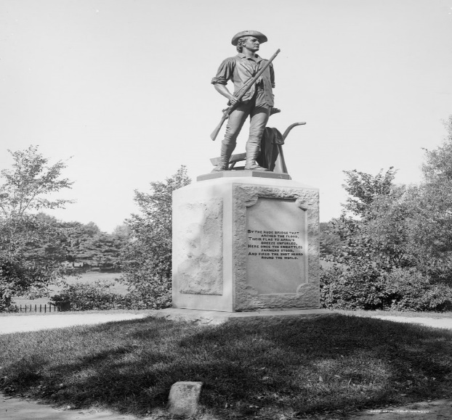
Town of Concord
FY24 INTERIM YEAR
TOWN CLASSIFICATION PRESENTATION
FISCAL YEAR 2024
November 20, 2023
Presented by:
The concord board of assessors
Brendan O’NEILL Kemeza, Chair
Office Staff
Meredith Stone, Town Assessor
Carolyn Dee, Office Administrator
Michael Gibbons, Assistant Assessor
Lee Phalen, Field Lister
Notes:
INCLUDING A RESIDENTIAL EXEMPTION SHIFT EXAMPLES AT A 10% SHIFT NEW FY24 STARTING JANUARY 2024

Slide 2
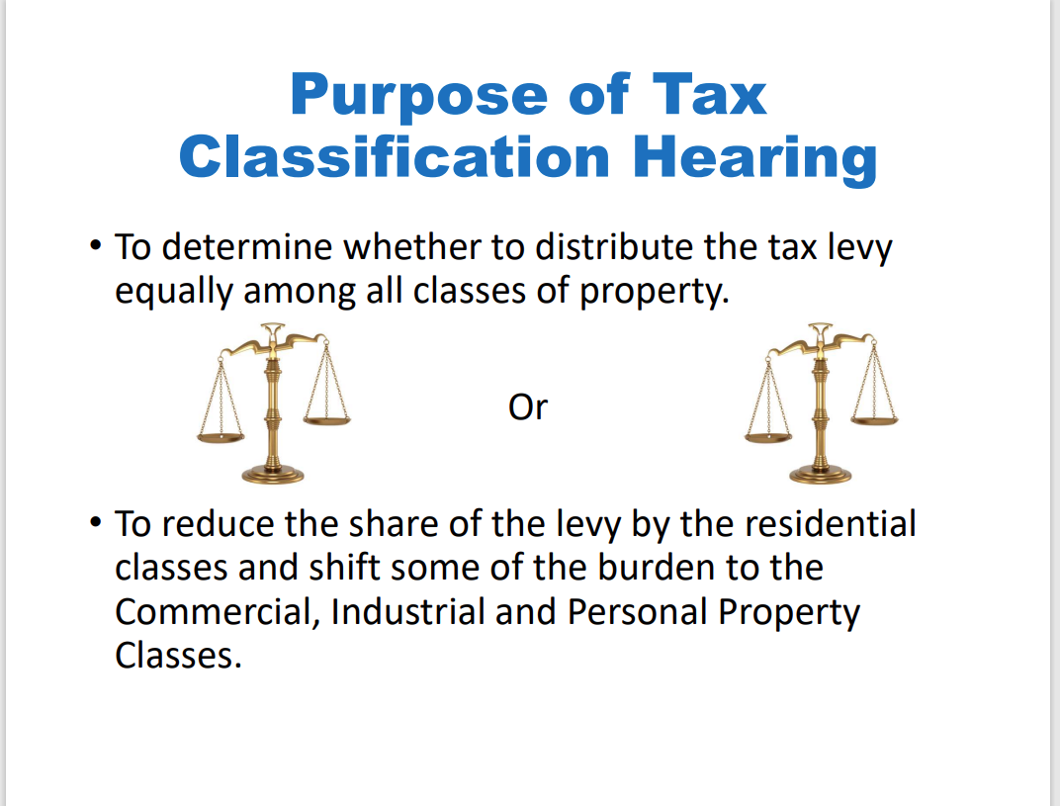
Notes:
FY24 RESIDENTIAL EXEMPTION SHIFT 10% WITHIN THE RESIDENTIAL CLASS TO REDUCE TO BURDEN ON LOWER VALUE HOMES TO HIGHER VALUE HOMES

Slide 3
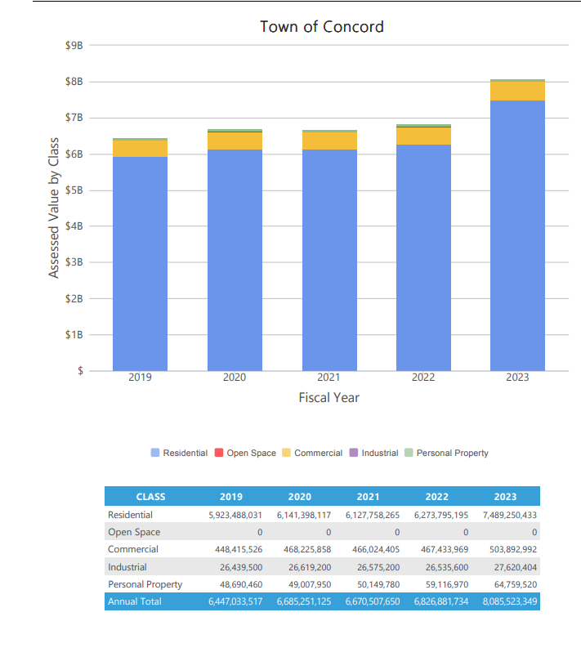
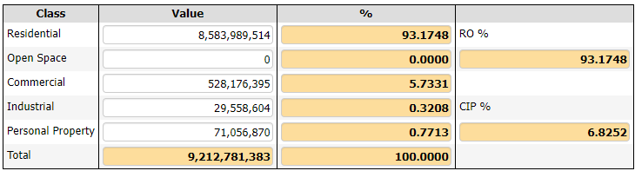
Historical Assessed Values By Class
FY24 Residential values on the chart are in the color purple showing how much difference between classes. The orange is the CIP Commercial, Industrial, Personal Property.

Slide 4
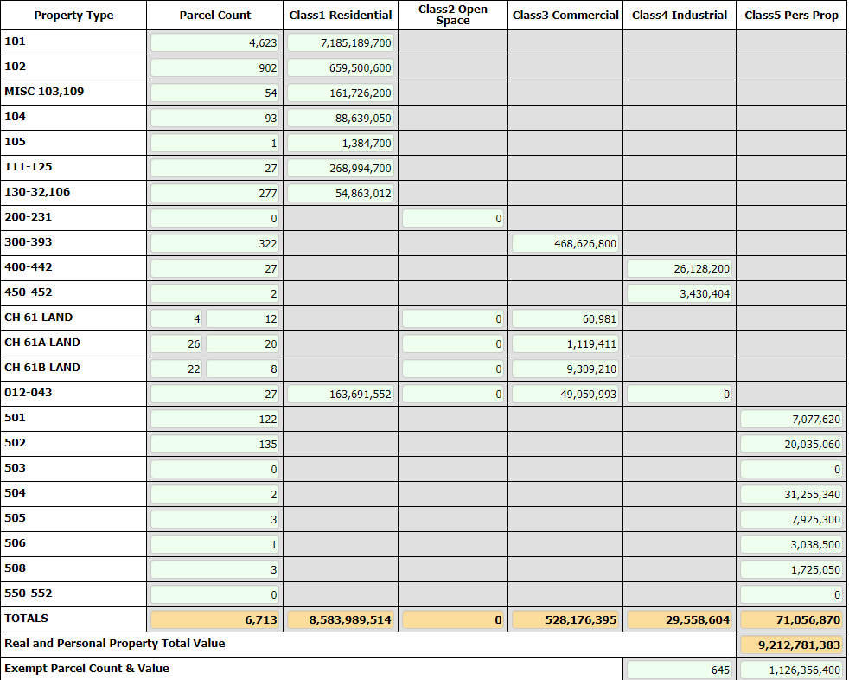
FY 2024 Property Tax Levy
FY 2024 Town Taxable Valuation
CALCULATING THE SINGLE TAX RATE
  FY 24 Proposed Levy divided by Town’s Taxable Value
  112,798,243
  9,212,781,383
  Single Tax Rate =$12.24
PER 1,000 OF ASSESSED VALUE IF A
FACTOR OF 1 IS SELECTED (NO SHIFT)
Notes:
FY24

Slide 5
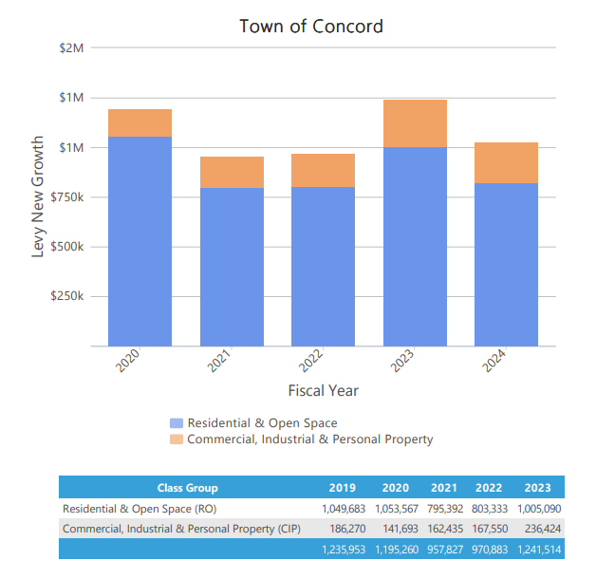
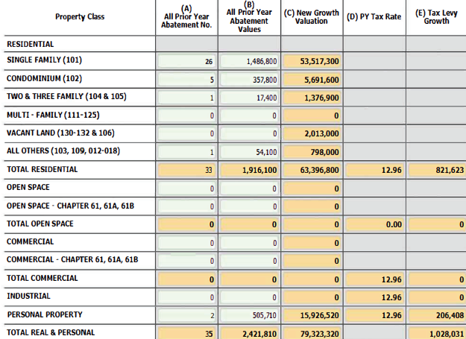


Slide 6
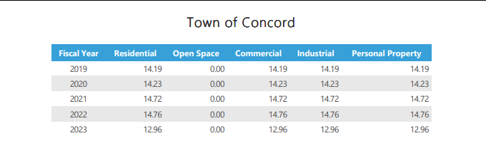
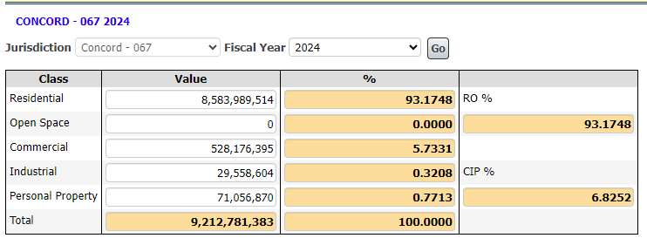
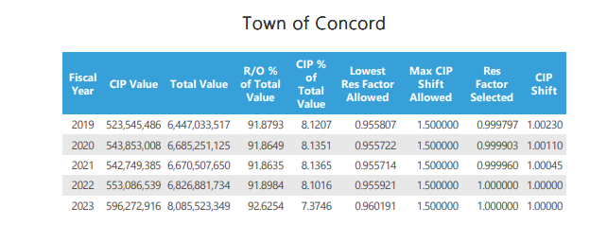

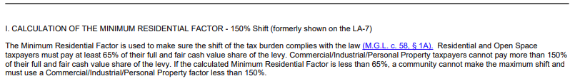

Slide 7
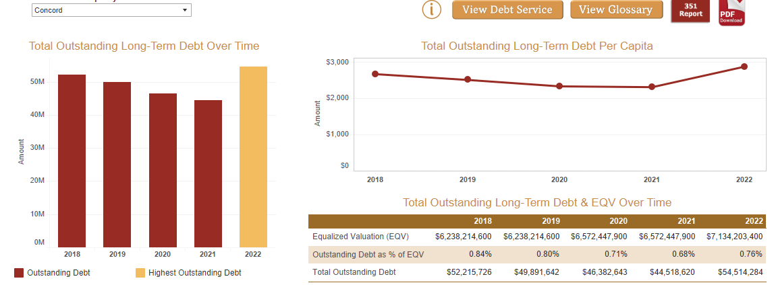

Slide 8
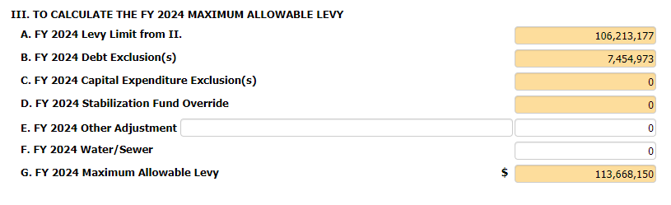

Slide 9
Tax Rate Calculation
Recommended FY2024 Tax Rate is $12.24/$1,000
$12.24 per thousand dollars of assessed value
FY2024 Property Tax Levy
$112,798,243
Town Taxable Valuation
9,212,781,383
or
 | FY23 | RE Taxes | FY24 | RE Taxes
Average Assessed Value 101-Single Family: | $ 1,358,866 | $ 17,610.90 | $ 1,554,227.00 | $ 19,023.74
Median Assessed Value 101-Single Family | $ 1,169,500 | $ 15,156.72 | $ 1,303,250.00 | $ 15,951.78
Average Assessed Value 102-Condominium | $ 687,601 | $ 8,911.31 | $ 731,154.00 | $ 8,949.32
Median Assessed Value 102-Condominium | $ 529,850 | $ 6,866.86 | $ 629,950.00 | $ 7,710.59

Slide 10
What is a Split Tax Rate?
Communities decide to tax Residential and Commercial, Industrial & Personal Property (CIP) differently.
Statute allows an increase in CIP’s share of the tax levy up to 50% higher than residential
Does not generate new revenue; reallocates levy burden
Concord has used a uniform tax rate since 1998. A Tax Rate Split has been adopted in the Town of Concord before.

Slide 11
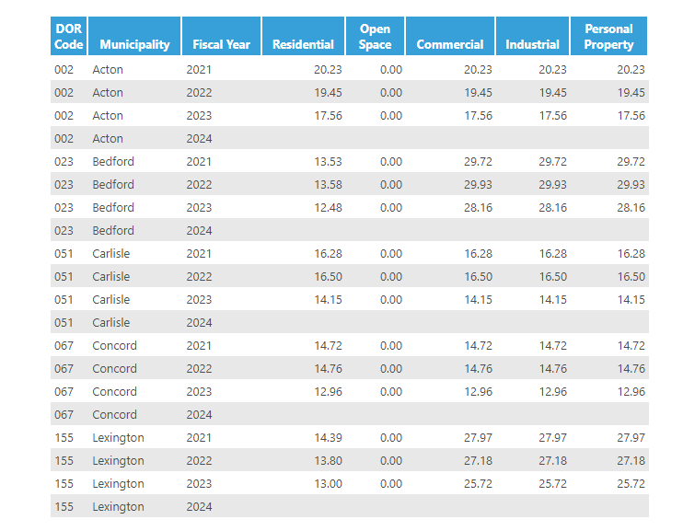
Tax Single and Split Rates
ACTON-SINGLE
BEDFORD-SPLIT
CARLISLE-SINGLE
CONCORD-SINGLE
LEXINGTON-SPLIT
CIP SPLIT RATE SHIFTS LARGE BURDEN OF LEVY

Slide 12
SHIFTING THE TAX RATE: OPTIONS

Slide 13
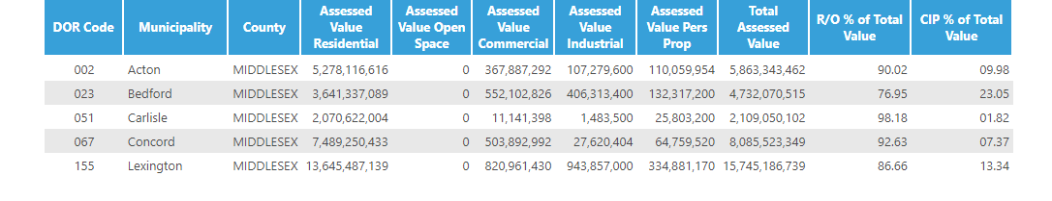

Slide 14
OPEN SPACE DISCOUNT
During the State mandated Classification Hearing, the Select Board must vote on the following in order to establish a tax rate:
OPEN SPACE DISCOUNT:
Open space is land maintained in an open or natural condition which contributes significantly to the benefit and enjoyment of the public and which is not
Subject to a permanent conservation restriction;
Held for the production of income;
Taxable under the provisions of
Chapter 61 (forest land)
Chapter 61A (farm land)
Chapter 61B (recreation land).
The Select Board may discount up to 25% of the Open Space share of taxes.

Slide 15
MGL c.59, sec. 5C
What Is It?
Enacted in 1979, the Residential Tax Exemption is an option under property tax classification MGL c.59, sec. 5C that shifts the tax burden within the residential class from owners of moderately valued residential properties to the owners of vacation homes, higher valued homes and residential properties not occupied by the owner, including apartments and vacant land.

Slide 16
Residential Exemption
Community | Percentage
Barnstable | 20
Boston | 35
Brookline | 20
Cambridge | 30
Chelsea | 35
Concord (NEW) | 10
Everett | 25
Malden | 30
Mashpee (New FY23) | 5
Nantucket | 25
Oaks Bluffs | 8
Provincetown | 35
Somerville | 35
Tisbury | 22
Truro | 25
Waltham | 35
Watertown | 33
Wellfleet | 25
• The Residential exemption applied is 1% up to 35% of the total average residential parcel value.
• The property must be the "primary domicile" of the owner as used for income tax purposes.
• This option exempts value only within the residential class of taxpayers & does not change the levy amount itself or impact Commercial Industrial or Personal (CIP) property owners
• The Select Board can authorize up to a 35% residential exemption
17 communities, out of 351 in MA, chose to adopt in FY23-FY24.
Concord has 4000 qualified properties for FY24 and the result of the adoption would be a higher tax rate for all residential properties.
NOTE: Not all residents who make Concord their primary domicile elect to apply and receive the exemption.

Slide 17

How Is It Calculated?
A = Total Residential Value = $8,583,989,514.00
B = Total Residential Parcel Count = 6004
C = Average Residential Value = $1,429,712
D = Selected Residential Exemption % = 10%
E = Residential Exemption = $142,971
F = Number of qualifying Residential Parcels = 4,000 G = Total Residential Exemption Value = $571,884,000
H = Total Residential Value - Exemption =$8,012,105,514

Slide 18
FY2024 Tax Rate w/out Exemption $12.24 per $1000
FY2024 Tax Rate w/10% Exemption $13.12 per $1000
FY2023 Tax Rate $12.96 per $1000

Slide 19
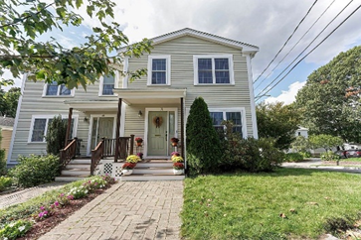
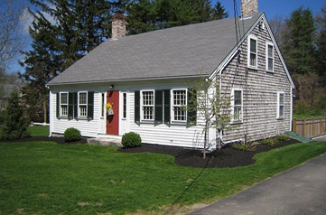
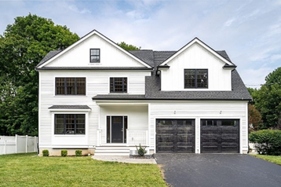
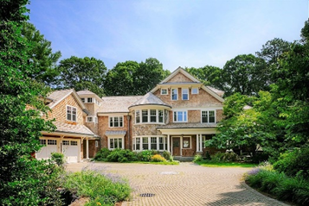
Residential Exemption: What if Scenarios

Slide 20
Who Benefits?
For Owner-Occupied Properties:
With No Residential Exemption Program
 | Property #1 | Property #2 | Property #3 | Property #4 | Property #5 | Property #6
Assessed Value | $400,000.00 | $1,303,250 | $1,554,227 | $2,145,997 | $2,500,000 | $5,500,000
Tax Bill With No Program Tax Rate $12.24 | $4,896 | $15,952 | $19,024 | $26,275 | $30,600 | $67,320
Eligible Properties- With Exemption Program
 | Property #1 | Property #2 | Property #3 | Property #4 | Property #5 | Property #6
 | Below Break Even | Median Value | Average Value | Break Even Point | Above Break Even | Well Above Break Even
Assessed Value | $400,000.00 | $1,303,250 | $1,554,227 | $2,145,997 | $2,500,000 | $5,500,000
Exemption | $142,971 | $142,971 | $142,971 | $0 | $142,971 | $142,971
Net Value | $257,029 | $1,160,279 | $1,411,256 | $2,003,026 | $2,357,029 | $5,357,029
Tax Bill with 10% Exemption Tax Rate $13.12 | $3,372 | $15,223 | $18,516 | $26,275 | $31,372 | $70,284
Actual Savings with Exemption | $1,524 | $729 | $240 | 0
Extra Cost of Exemption |  |  |  | 0 | $772 | $2,964
Notes:
Without Residential Exemption $12.24 with Residential Exemption $13.12 @10% shift Residential Levy $105,099,537/8,012,105,514 Res Value minus Exemption=$13.12

Slide 21
Options for Residential Exemption
Example Calculation of 10%
Exemption 1% to 35% of the Average Residential Value
5% * $1,429,712 = $71,486 Tax Rate $12.67
10% * $1,429,712 = $142,971 Tax Rate $13.12
15% * $1,429,712 = $214,457 Tax Rate $13.60
20% * $1,429,712 = $285,942 Tax Rate $14.13
25% * $1,429,712 = $357,428 Tax Rate $14.69
30% * $1,429,712 = $428,914 Tax Rate $15.30
35% * $1,429,712 = $500,399 Tax Rate $15.97

Slide 22

The Select Board could adopt an exemption that reduces the taxable valuation by up to 10% of eligible Commercial parcels only.
Eligible businesses must have an average annual employment of not more than 10 people during the previous calendar year.
Assessed value of the parcel occupied by eligible business must be $1 million or less.
For a commercial parcel to qualify, every business occupying the parcel must also qualify for the exemption.
This exemption shifts the tax burden within the CIP Classes from small commercial properties to larger commercial and industrial parcels.
Increases the Commercial/Industrial/Personal Property Tax Rate.
The exemption goes to the building owner, not the business owner, so depending on lease agreements, a small business owner may or may not benefit.
Concord has not historically adopted this exemption

Slide 23
Select Board’s Role
Selection of a Minimum Residential single or split
Selection of an Open Space Discount-or not
Adopting of a Residential Exemption or not
Adopting of a Small Commercial Exemption or not
The Select Board hold a public hearing to determine the percentage of the Town’s property tax levy to be borne by each major property class.

Slide 24
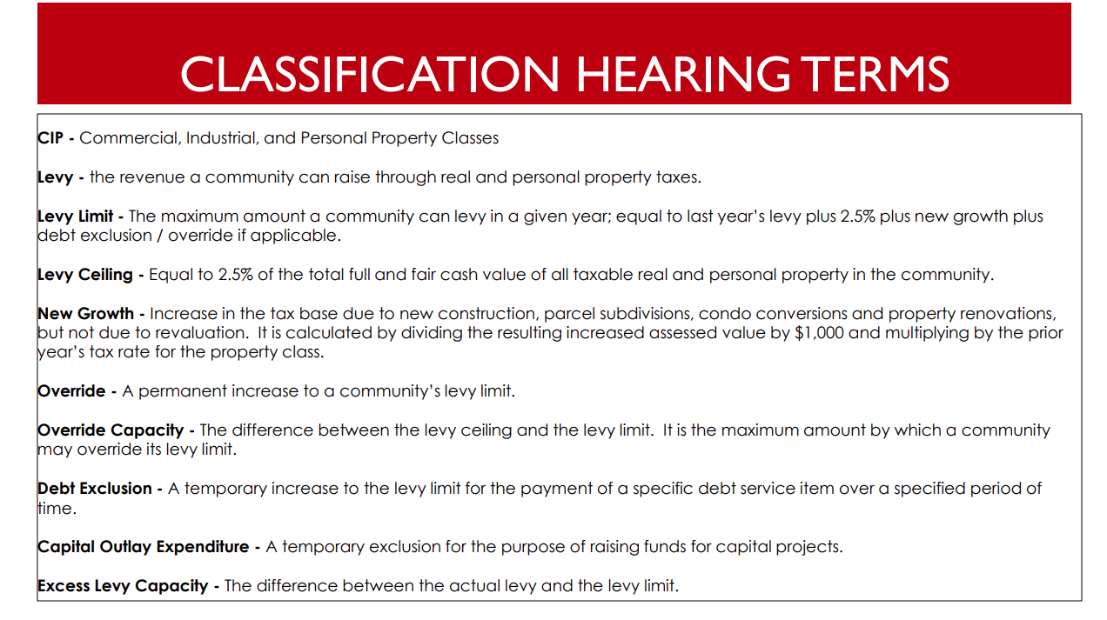
Add a Slide Title - 5

Slide 25
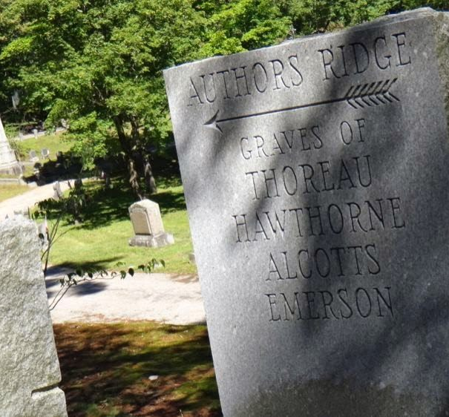


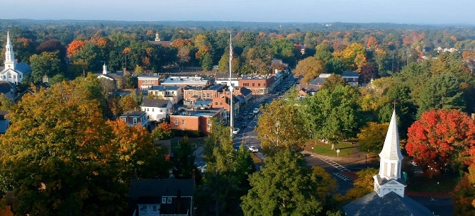
Town of Concord Massachusetts
Classification Hearing
FY24 Interim
Board of Assessors
Brendan O’Neill Kemeza ,Chair
Mera Krishnan Tilley, Vice-Chair
David Karr
Yanni Tsitsas
Arry Charles
Office Staff
Meredith Stone, Town Assessor
Carolyn Dee, Office Administrator
Michael Gibbons, Assistant Assessor
Lee Phalen, Field Lister
11-20-2023
Notes:
Concord Assessors Office 24 Court Lane Concord Massachusetts 01742

