Slide 1
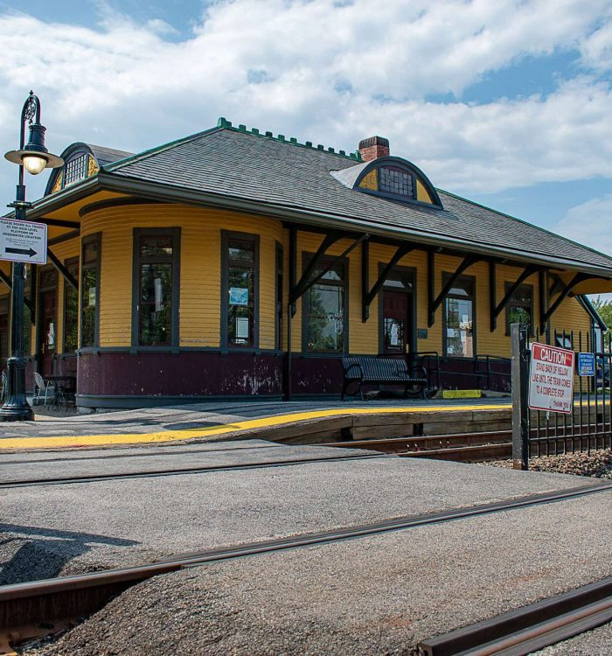
Concord MBTA Communities Public Discussion
Location and Zoning Standards
July 26, 2023

Slide 2

Horsley Witten Group (HW) – Planning and Engineering firm based in Sandwich, MA
Jeff Davis, Senior Planner – Based in our Providence, RI office
Providing free technical assistance to MBTA Communities through the Massachusetts Housing Partnership (MHP)

Slide 3
Sec. 3A of MGL c. 40A – Reminder . . .
MBTA Communities must have at least one zoning district in which multi-family housing is permitted by right (which can include Site Plan Review) and . . .
Minimum gross density of 15 units per acre
Located not more than 0.5 miles from a transit station, if applicable
No age restrictions and suitable for families with children, i.e. no bedroom or occupancy caps
Parity with other uses – multi-family housing cannot be required to meet higher standards than other permitted uses

Slide 4
Compliance Guidelines
Released by DHCD (now EOHLC) in August 2022
Provides step by step instructions for compliance
Includes a “Compliance Model” that calculates whether a municipality’s zoning and other policies comply with the law
Goal: Help the Town develop a zoning framework that meets local needs and complies with the MBTA Communities law by testing it in the Compliance Model.

Slide 5
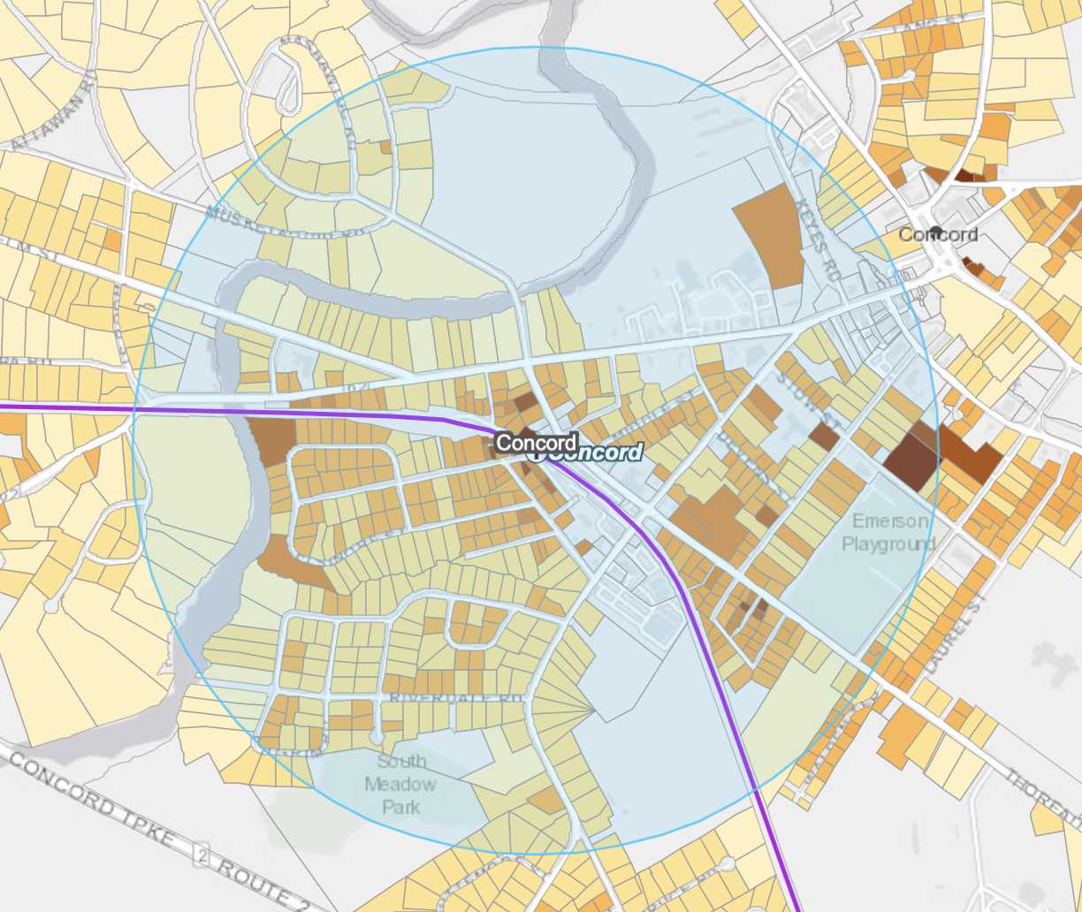
Requirements for Concord
Commuter Rail Community
Deadline: December 31st, 2024
Population: 17,669
Current housing units: 7,295
Minimum Land Area: 50 acres
Developable Station Area: 519 acres
Minimum Multifamily Unit Capacity: 1,094 (15% of Concord’s 2020 housing stock)
% of District to be located in Station Area (1/2 mile radius around the stations): 50%

Slide 6
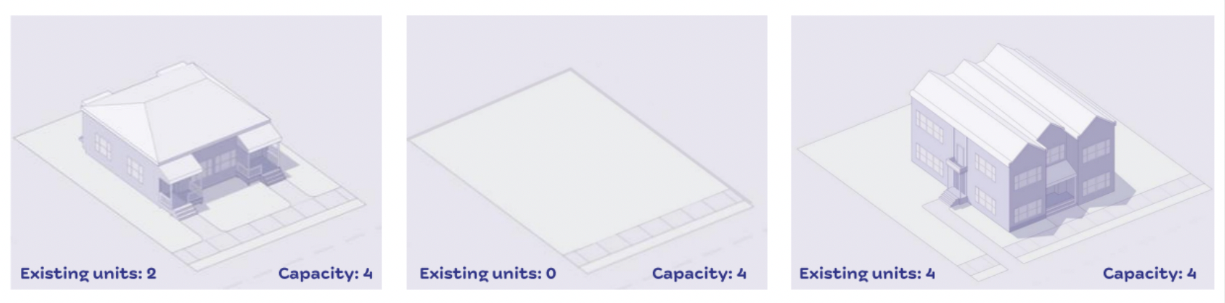
What does zoning capacity mean?
Capacity = what could theoretically be built under the new zoning code
It is NOT a production mandate!
Think of it as a menu or a cookie tray

Slide 7
Testing the Compliance Model
HW will help the Town test the compliance model
Step 1: Determine district boundaries. Where might multi-family residential be appropriate? Focus on the areas ½ mile around the two MBTA stations, but 50% can be elsewhere.
Step 2: Determine dimensional requirements. How tall should buildings be in this district? What setbacks? What density?
Step 3: Ensure all zoning policy for the district complies with the law (affordable housing, policies that would limit family-sized units, etc.)
Step 4: Enter this data into the Compliance Model and “test” different iterations.

Slide 8
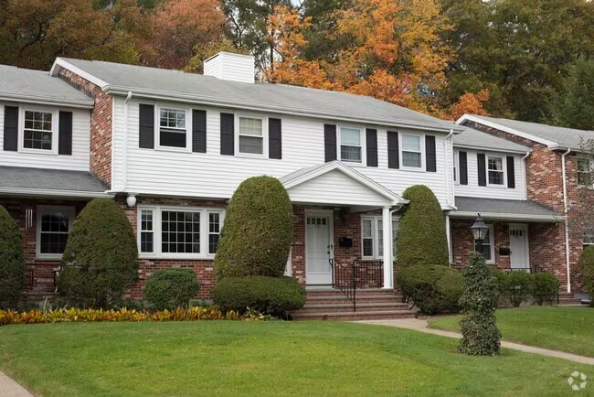
Breakout Room Discussions
Each group will have a facilitator . . .
WHERE we think it would be appropriate to allow multi-family housing by right (meaning without a special permit, variance, etc.)?
Guiding principles for where such development might be appropriate
Brainstorming of specific desirable locations
Would different building heights be appropriate in different locations?
Wedgewood Common

Slide 9
Breakout Room Discussions
Potential performance standards for Location
As much as possible within ½ mile of an MBTA station (only 50% is required to be in these areas)?
Fully or primarily in West Concord? Concord Center?
~ evenly between West Concord and Concord Center?
Where multi-family housing exists today or is planned?
Avoid areas where ground floor commercial uses are desired (cannot require ground floor commercial use or mixed-use – a residential-only building must be an option).
Avoid areas where naturally affordable (i.e. not subsidized) housing exists today, such as 2-family homes, rental units, etc.?

Slide 10
Breakout Room Discussions
Mapping Tool
We will demonstrate the mapping survey prior to break outs
  Online survey will be available for the community to provide more detailed input
  Scroll to specific locations where you think multi-family housing is appropriate – “drop a pin” and explain why
Map shows . . .
  Existing and proposed multi-family housing in Concord
  Areas identified for affordable housing in the Housing Production Plan
  ½ mile radius around stations, current zoning, and “excluded areas”

Slide 11
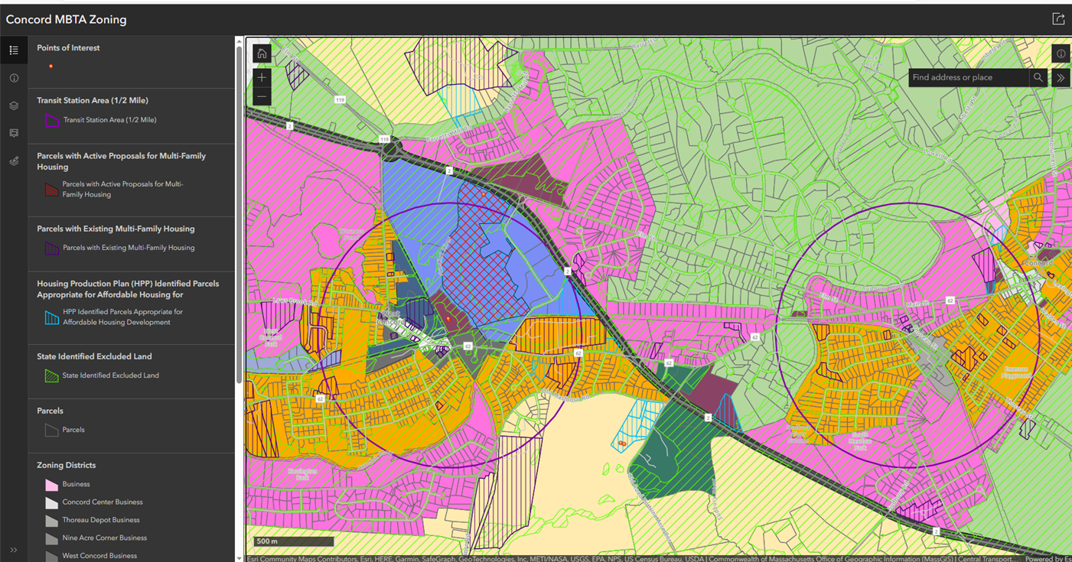
Mapping Tool Demonstration

Slide 12
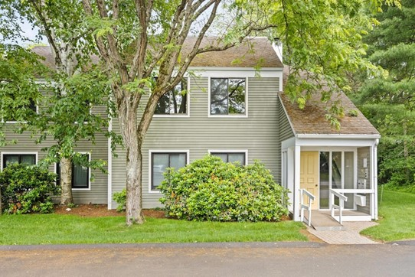
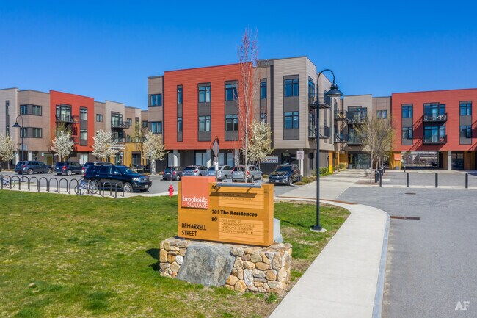
Breakout Room Discussions
See you back in the main room!
Concord Greene
Brookside Square

Slide 13
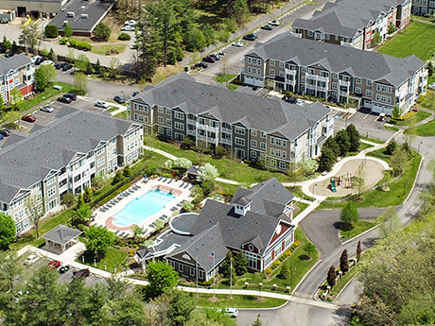
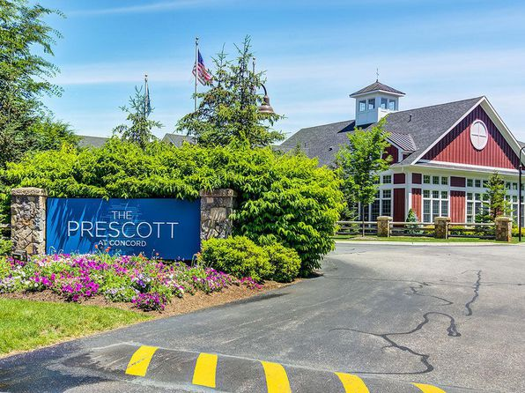
Report back!
What were the top two ideas/concerns from your group?
One minute per group!
The Prescott at Concord

Slide 14
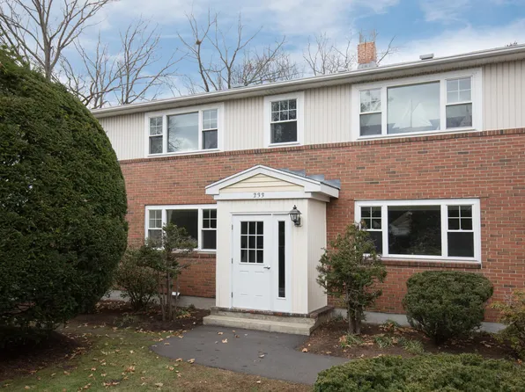
Next Steps
Discussion for August: Zoning Standards
WHAT standards should apply to multi-family housing by right?
State law places limits on the types of standards municipalities can apply
CAN set standards for . . .
  Building Height
  Setbacks
  Open Space
  Parking
  Etc.
Elsinore Street Apartments

Slide 15
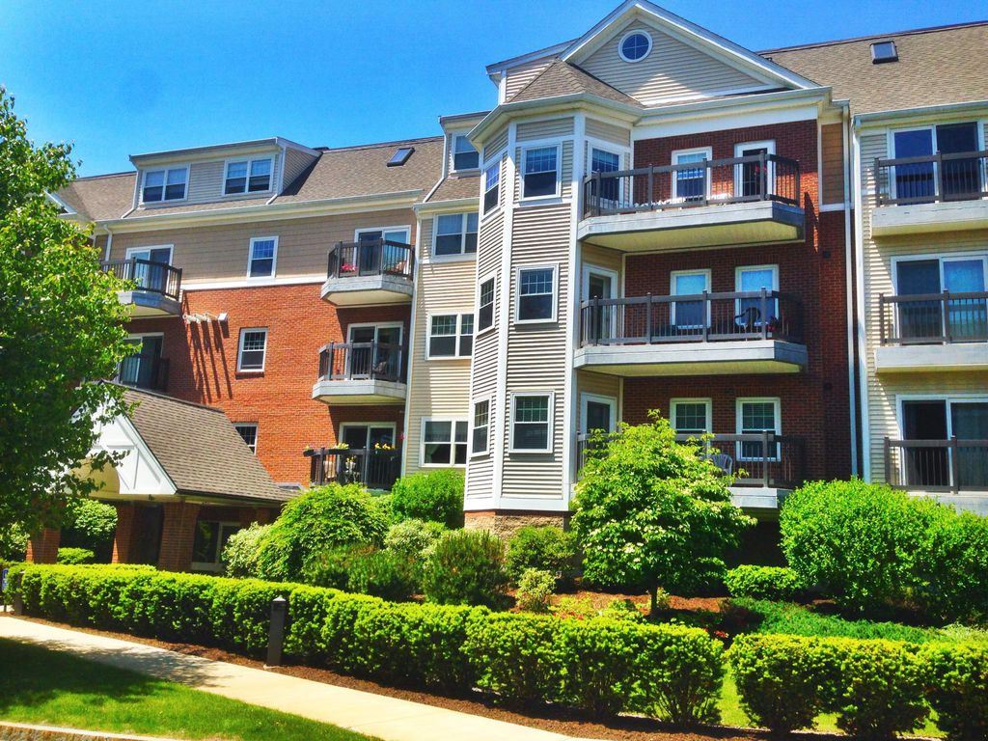
Next Steps
What building height should be allowed? (continued)
Should the Town use incentives to get developments that go beyond what is allowed by right?
  Example: If 1 story buildings are allowed by right, allow 3 stories with a special permit in exchange for providing . . .
    Ground floor commercial/mixed-use
    Public green space
    Public realm improvements
    Affordable housing, etc.
Other thoughts/concerns?
Warner Woods

Slide 16
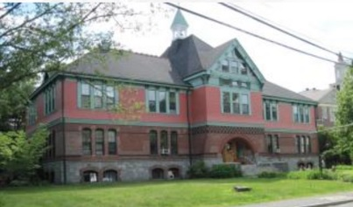
What is up next!
Upcoming Dates
MBTA Communities Workshop Zoning Standards
August 23rd 6:30 p.m. – 8:30 p.m. (Virtual)
MBTA Communities Workshop Draft Zoning Boundary & Zoning Standards
September 20th 6:30 p.m. – 8:30 p.m. (Hybrid – Harvey Wheeler Community Center)
Connection Hour – ask your MBTA Communities questions and provide feedback in a casual setting with Planning Staff and/or Planning Board members:
Haute Coffee on August 1st from 10-11 am
Verrill Farm on August 7th from 9-10 am
Nashoba Brook Bakery on August 17th from 1-2pm
Zoom on August 23 from 12-1 pm, virtual
Emerson Annex

Slide 17
Thank you!
Please visit the Town’s webpage
Concordma.gov/mbtacommunities and take the MBTA Communities Survey.

