Slide 1
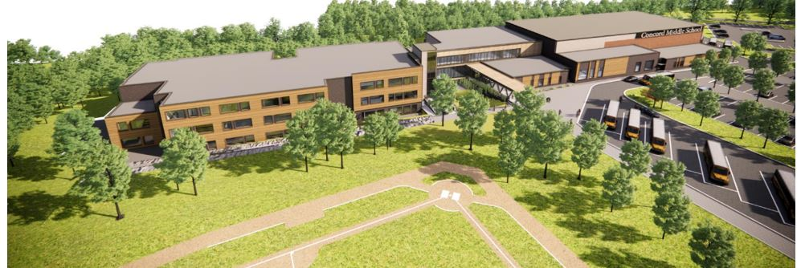
ARTICLE 5. Middle School Building Project
ARTICLE 5: Middle School Building Project
Motion: As printed in the handout

Slide 2
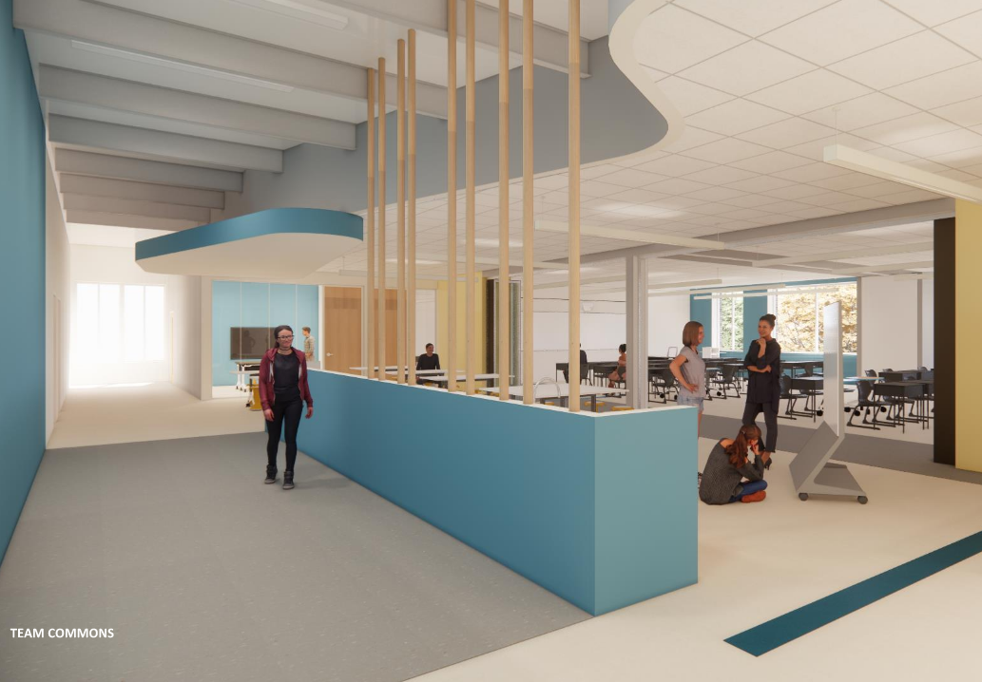
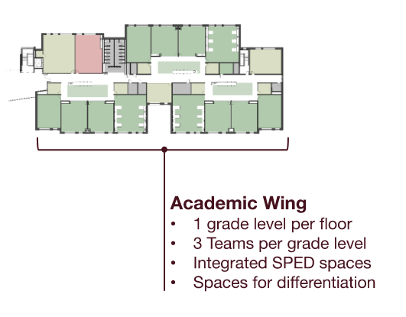
Project Highlights: Educational Programming
ARTICLE 5: Middle School Building Project
Design enrollment 700 students for grades 6-8
Supports implementation of the Team-Teaching Model to meet the Ed Plan
1 grade level per floor; 3 teams per grade level; integrated SPED spaces
Inclusive design to serve students of all abilities

Slide 3
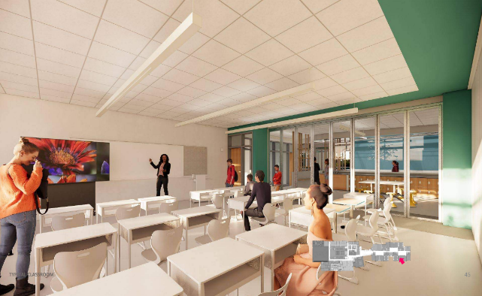
Project Highlights: Educational Programming, continued
ARTICLE 5: Middle School Building Project
Classrooms with significant natural light
Connection with nature through integrated design concepts and expose to surrounding forest
Media Center equal to the existing middle school libraries combined; located in the heart of the school
Co-located Art & World Languages

Slide 4
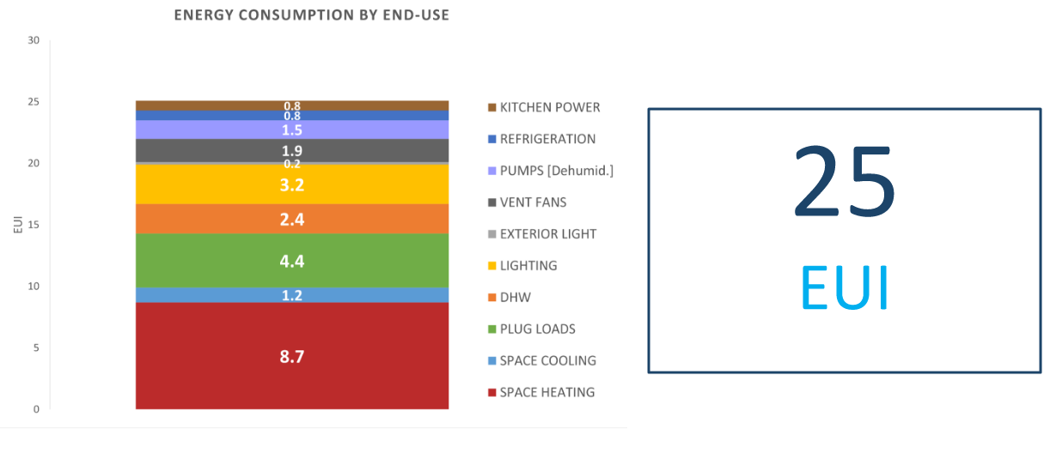
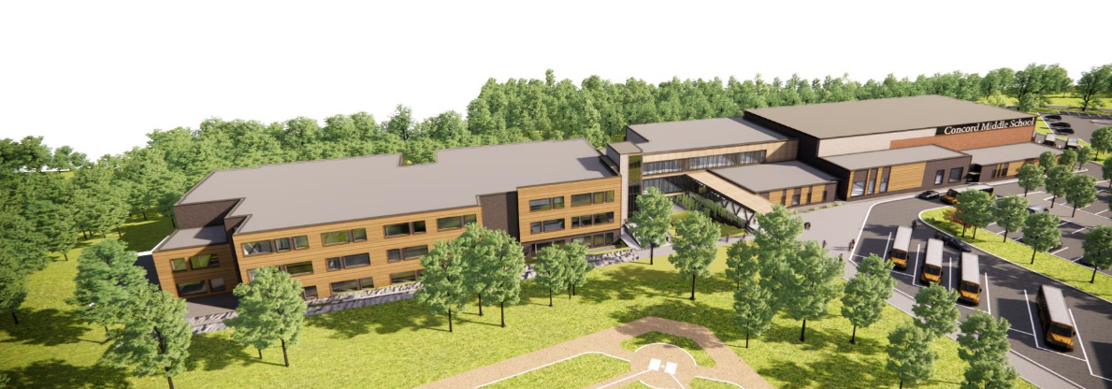
Project Highlights: Sustainability
ARTICLE 5: Middle School Building Project
Net Zero Ready Energy
Predicted EUI of 25 kBtu/SF/yr
Highly insulated exterior enclosure
with triple pane windows
All electric heating and cooling
Photovoltaic system readiness
Water reduction measures
Bioswales and native plantings
Sustainability measures equivalent
to LEEDv4 Certifiable

Slide 5
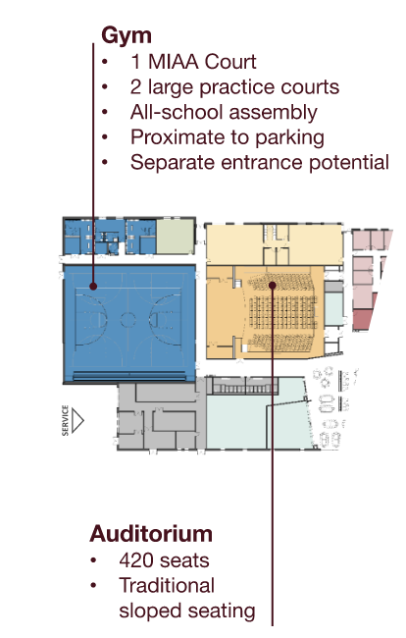
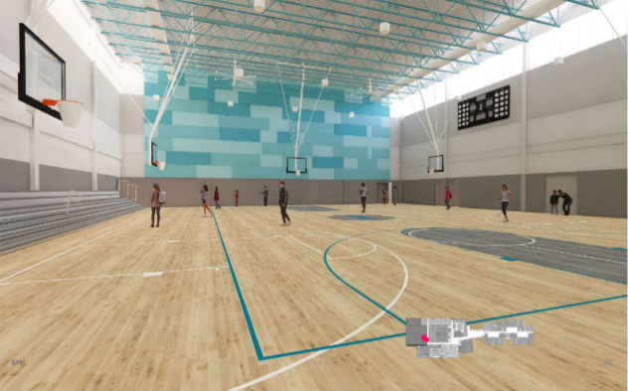
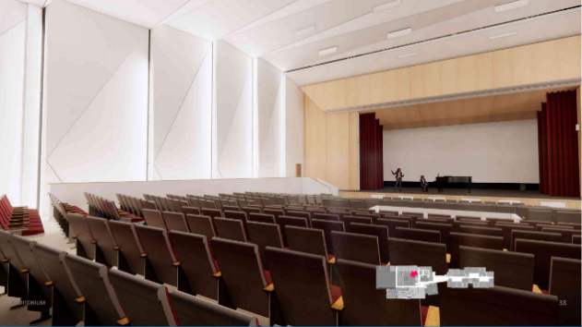
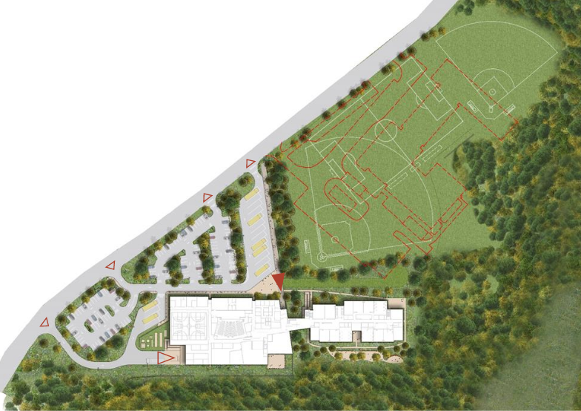
Project Highlights: Public Spaces
ARTICLE 5: Middle School Building Project
“Public” wing for community use after hours
1 MIAA court with 2 large cross courts
420 seat auditorium
Natural grass athletic fields

Slide 6
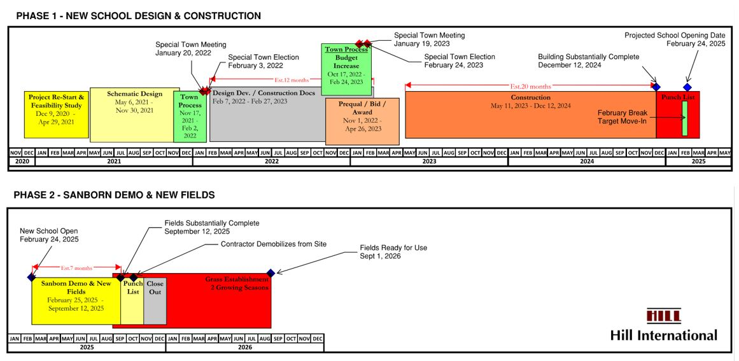
Project Schedule
ARTICLE 5: Middle School Building Project

Slide 7
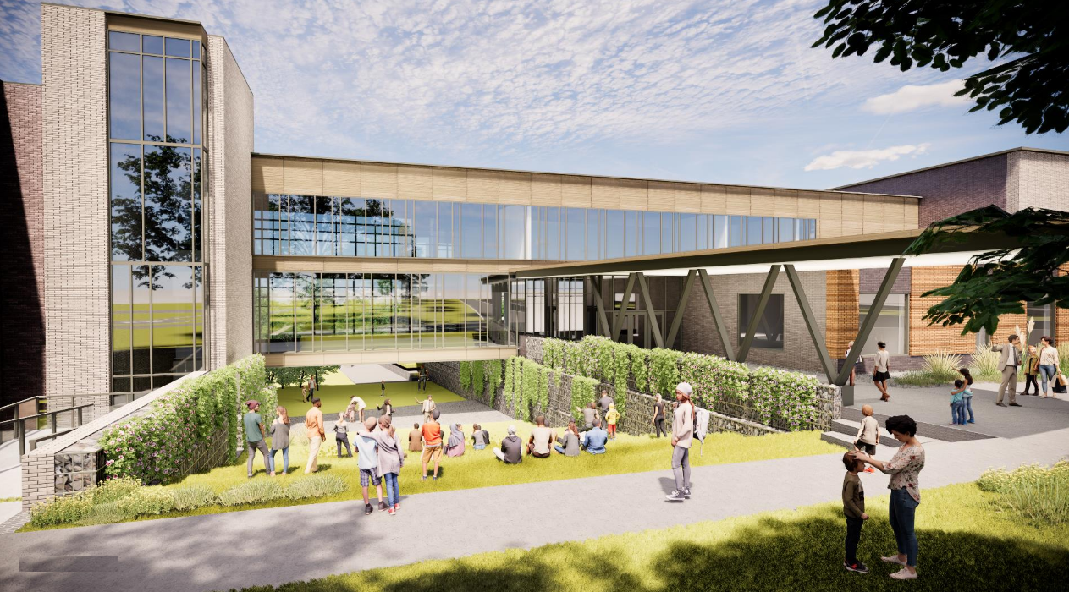
Concord Middle School – Current Scope *Consistent with scope approved at the Special Town Meeting in January 2022, less Value Management accepted in Design Development and 60% CD Phases
ARTICLE 5: Middle School Building Project
Current Cost
Current Cost including $6,184,098 VM Decisions to Date
$108.3M
Includes $86M construction cost, soft costs, contingencies @ 5% and a $2M bid contingency

Slide 8
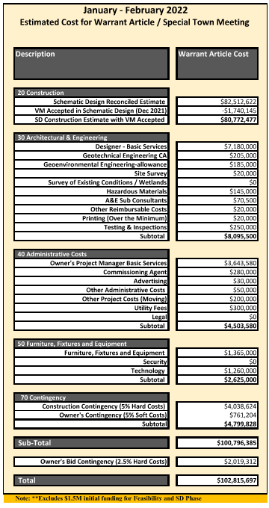
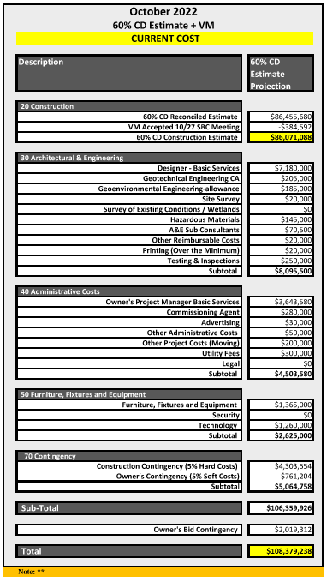
Budget vs. Current Cost Estimate @ 60% Design
ARTICLE 5: Middle School Building Project
STM Budget
January 2022
$102,815,697
60% CD Estimate
October 2022
$108,379,238
$5,563,541 Overrun
Scope Cut @ Increased Cost Why?

Slide 9
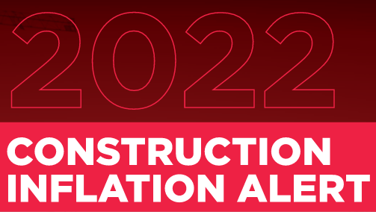
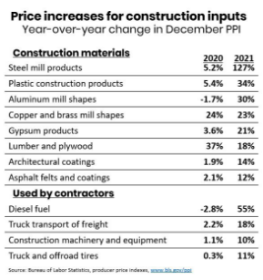

Construction Costs are impacted by Market Inflation
ARTICLE 5: Middle School Building Project
Contributors to runaway costs
“What has contributed to
these extreme cost increases?
In brief: nearly everything.”
Source: AGC Construction Inflation Alert

Slide 10
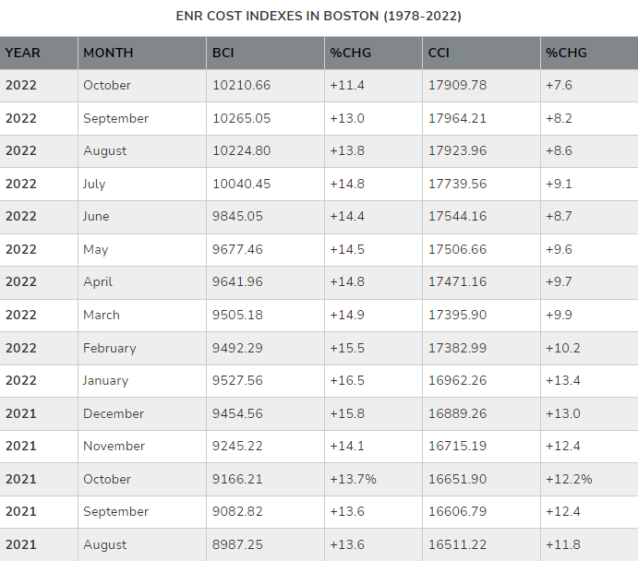
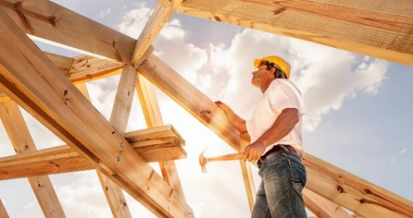
Greater Boston Commercial Construction Market
ARTICLE 5: Middle School Building Project
The average year over year inflation for commercial construction in Boston in 2021-22 was 8.7%.
Over the last decade, the average year over year inflation rate was 3.1%.
We have seen
unprecedented
inflation in 2022!
Source: ENR Quarterly Report

Slide 11
Comparable Recent Construction Project Bids
ARTICLE 5: Middle School Building Project
High School: 90% CD - Stoneham
Construction Budget: $153.4m
Construction Estimate 90CD: $163.4m (+6.5%)
90 % Estimate Sept, Bid December 2022
Submitted 90% CD, added outside funding, significant VE, Stadium Building bidding as Alternate, re-allocated contingencies CMAR
Elementary School - Swampscott
Construction Budget: $76.5m
Construction Bid: $79.7m
Bid received October 2022(+4.1%)
DBB

Slide 12
Comparable Recent Construction Project Bids
ARTICLE 5: Middle School Building Project
Mid-Size Regional High School – Nauset
Construction Budget: $105m
Construction Bid: FSB only $20m
Bid received June 2022 (+20%)
No HVAC bids received, Bid Protests, District moving Bid date out 3-4 months and seeing additional funds DBB
Large Suburban Elementary School – Andover
Construction Budget: $119.2m
Construction Bid: $136.2m
(+14%)
Significant VE at DD & 60%. STM scheduled Dec 1, 2022
CMAR

Slide 13
Comparable Recent Construction Project Bids
ARTICLE 5: Middle School Building Project
Large Suburban Elementary School – Groton
Construction Budget: $61.0m
Construction Bid: $70.5m
(+15.6%)
Based on 60% CD in August 2022
Approved 9.5M at STM 9.12.22
CMAR
Suburban Elementary School – Westwood
Construction Budget: $70.0m
Construction Bid: $74.0m
Bid received July 2022 (+5.7%) Used ARPA and other Town Funds to bridge gap
DBB

Slide 14
Comparable Recent Construction Project Bids
ARTICLE 5: Middle School Building Project
Middle School - Concord
Construction Budget: $80.7m
Construction Estimate (DD): $86m
(+6.5%)
Significant VE & Going back to Town for additional funds
DBB
Middle School - Somerset
Construction Budget: $69m
Construction Bid: $79m
Bid received July 2022 (+14.5%)
Failed vote at STM August 22
CMAR

Slide 15
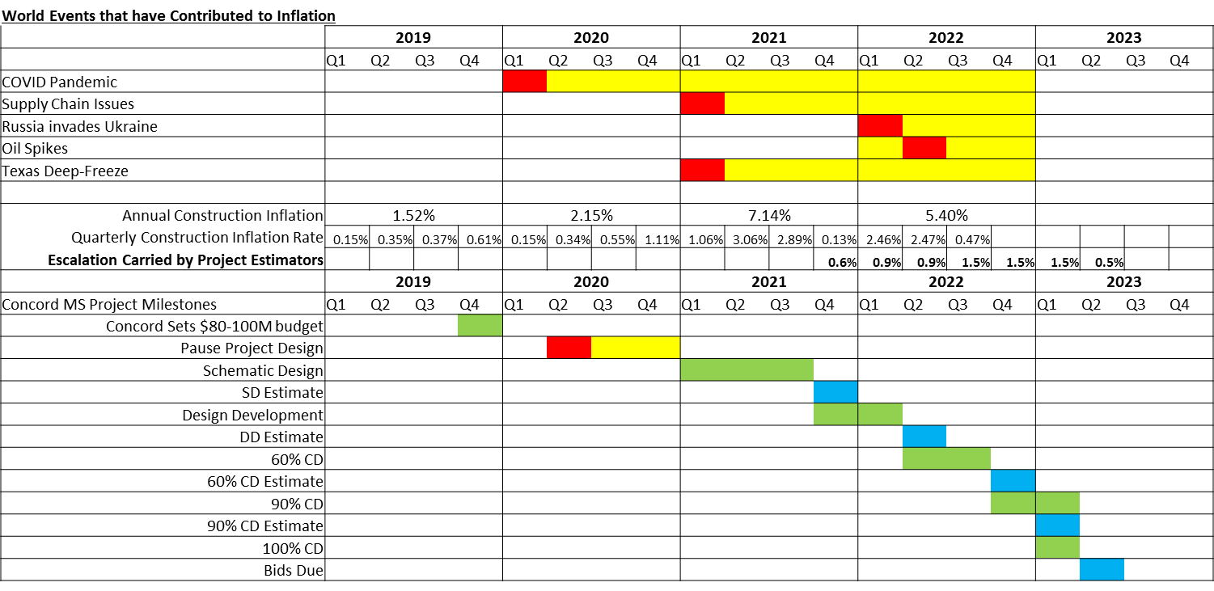
Looking Forward to 2023 - Observation: Inflation appears to be flattening
ARTICLE 5: Middle School Building Project

Slide 16
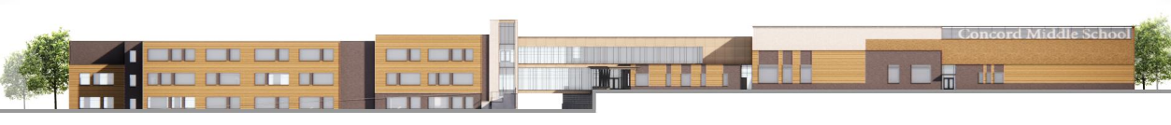
Value Management January 2021 thru October 2022 $6,184,098 total estimated savings
ARTICLE 5: Middle School Building Project
SUMMARY OF ACCEPTED VALUE MANAGEMENT
2021 $ 2,180,100 Feasibility Study - completed April 2021
$1,740,145 Schematic Design – completed Nov 2021
2022 $1,879,261 Design Development – completed June 2022
$384,592 60% CD Estimate – completed October 2022
$6,184,098 Total (Construction Cost Savings)

Slide 17
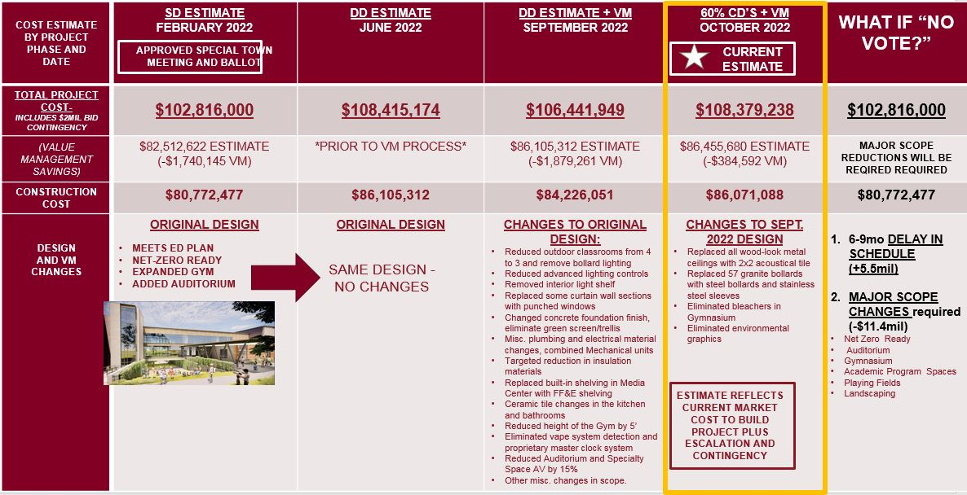
Concord Middle School Project – Year in Review
ARTICLE 5: Middle School Building Project

Slide 18
RECAP: Warrant Article Timeline & Next Steps
ARTICLE 5: Middle School Building Project
October 27, 2022 - CMSBC recommendation to Select Board @ $115M
October 28, 2022 - Select Board vote for Warrant Article @ $110M (Current Warrant Amount)
January 13, 2023 - 90% CD Estimate to CMSBC
If estimate < $110M, then proceed with $110M NTE budget
If estimate > $110M, then TBD (CMSBC to discuss strategy 11.17 with likely deduct alts)
January 17, 2023 – Motions posted for Special Town Meeting
January 19, 2023 – Special Town Meeting
Date to be Announced – Special Town Vote

Slide 19
If Article Doesn’t Pass
ARTICLE 5: Middle School Building Project
Financial Impact
Construction inflation ~ 0.7% month
For a 6-9 month delay, this corresponds to a $3.6M - $5.4M increase in construction costs
CPS spends ~$50K per month on operating costs for existing MS
For a 6-9 month delay, this corresponds to $300K - $450K in operating costs
Redesign will cost ~$600K
Total estimated cost impact is $4.5M - $6.5M depending on the duration of the delay

Slide 20
If Article Doesn’t Pass
ARTICLE 5: Middle School Building Project
Schedule Impact
Estimated 6-9 Month Schedule Delay
Redesign to get back to $102.8M budget
Redo pre-qualification process
Statement of Qualifications are only valid for 90 days after opening
Projected School Opening Sept 2025 in lieu of Feb 2025

Slide 21
If Article Doesn’t Pass
ARTICLE 5: Middle School Building Project
STM Vote Fails, Revert Back to $102.8M Budget
$108.7M Current Cost Estimate @ 60% CD
plus ~ $5.5M Cost for 6-9 Month Schedule Delay
equals $114.2M
Minus ~$11.4M scope reduction required to get “Back to Budget”
Equals $102.8M
Significant Scope Reduction

Slide 22
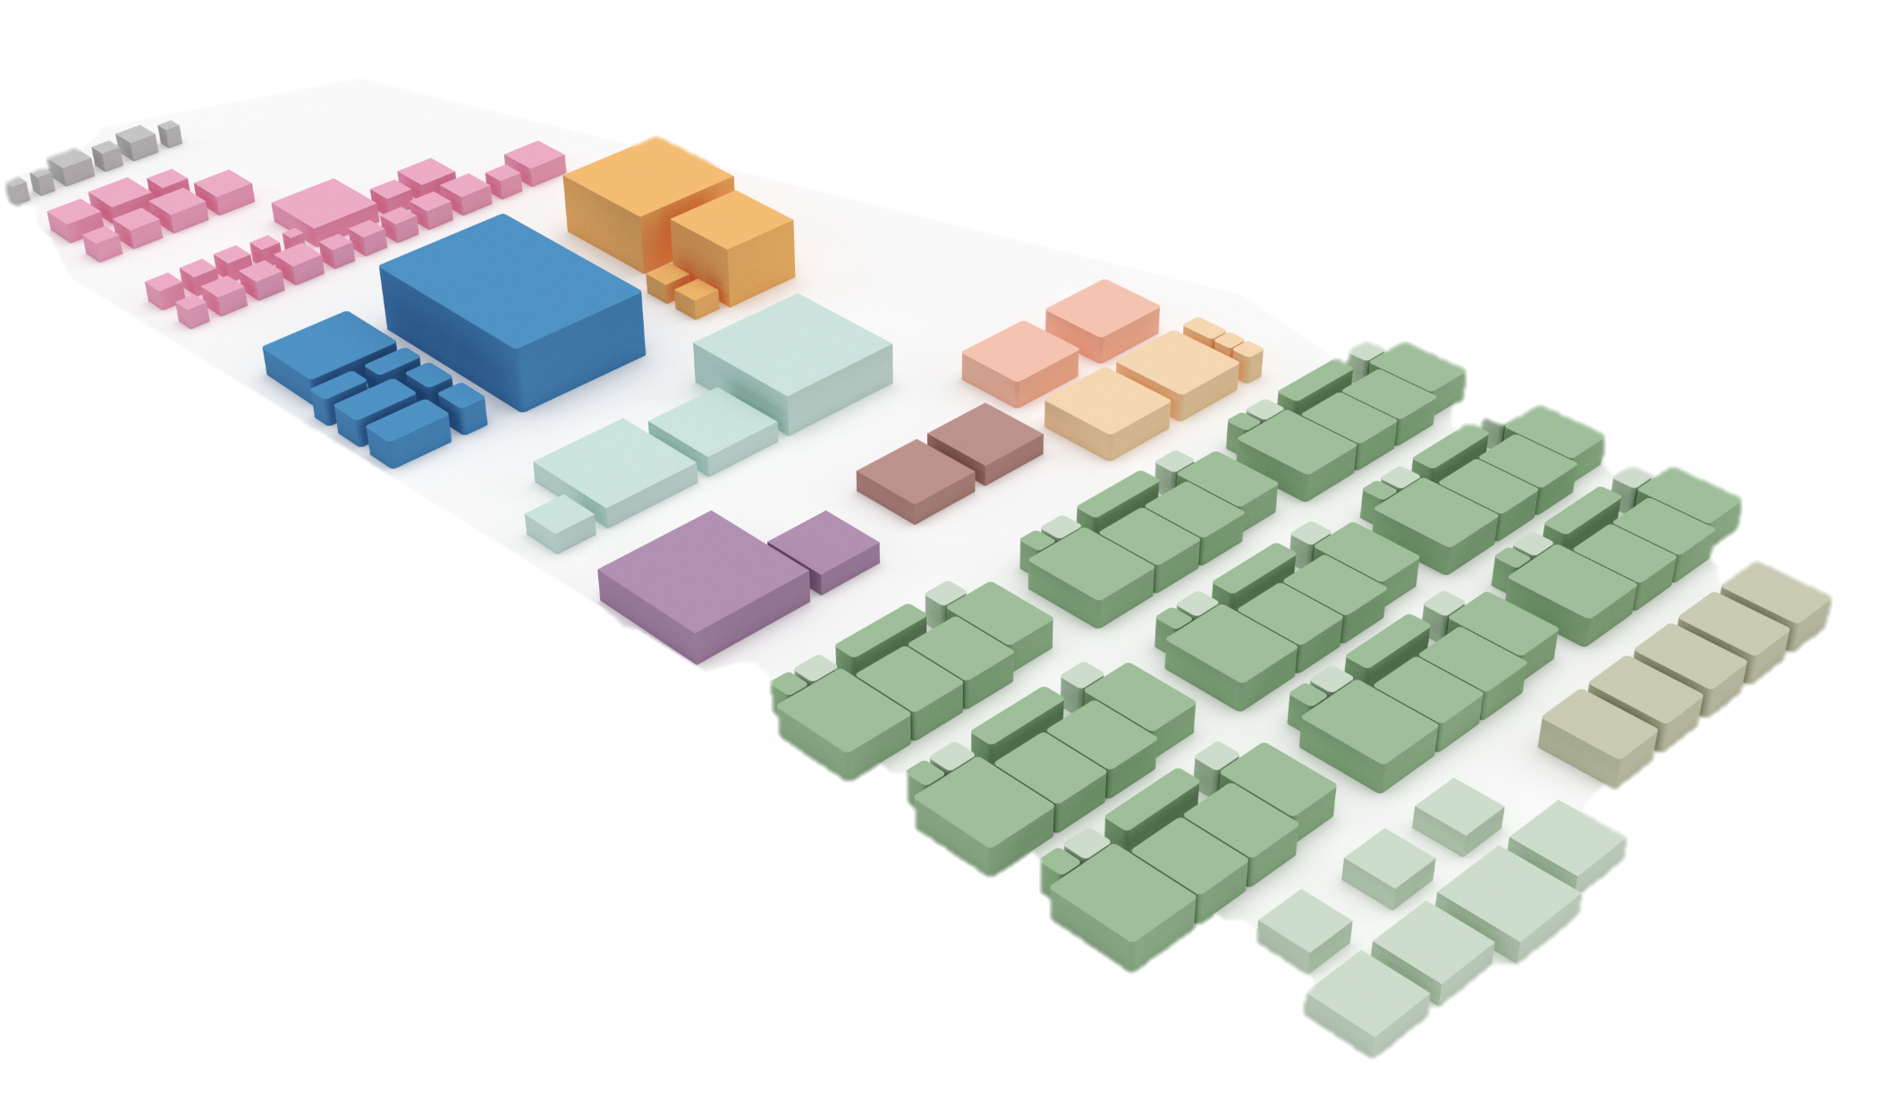
RECAP: Feasibility Study Value Management $2,180,100 total estimated savings
ARTICLE 5: Middle School Building Project
SUMMARY OF DECISIONS
Remove ALT PE
2,400 GSF @ $559/SF
Remove Maker Space
1,500 GSF @ $559/SF
Remove Alt PE SF
Remove Maker Space SF

Slide 23
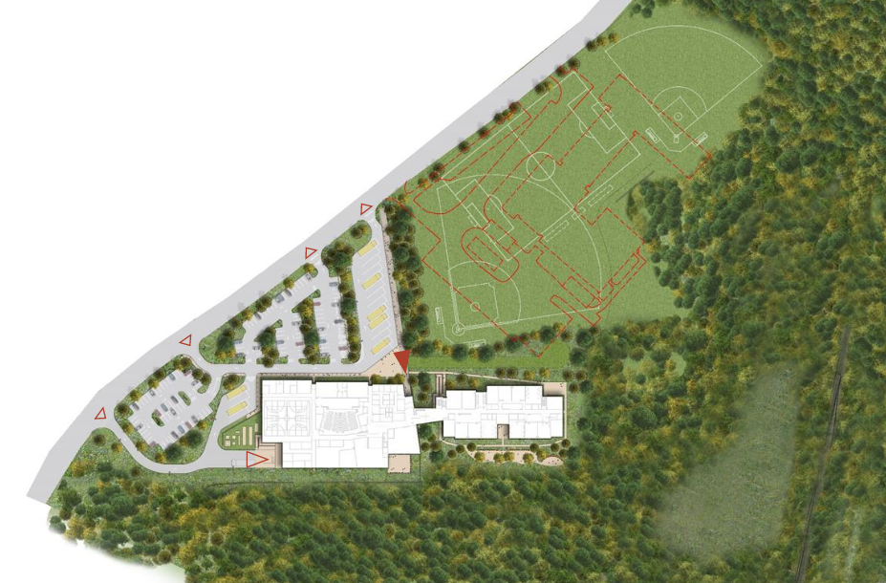
RECAP: Schematic Design Value Management $1,740,145 total estimated savings
ARTICLE 5: Middle School Building Project
SUMMARY OF ACCEPTED VALUE MANAGEMENT
Stockpile existing soils on site
Reduce wood-look metal ceilings
Eliminate wood wall paneling in the Media Center
Eliminate CMU walls in back-of-house spaces and Gym
Eliminate roof screens
Remove 934 GSF from building footprint
Reduce height of glazing at connector

Slide 24
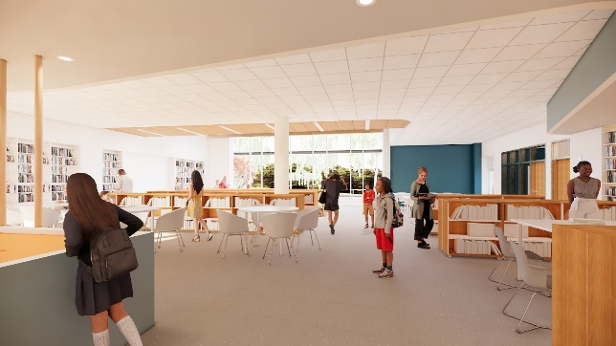
RECAP: Design Dev. Value Management $1,879,261 total estimated savings
ARTICLE 5: Middle School Building Project
SUMMARY OF ACCEPTED VALUE MANAGEMENT
Reduce outdoor classrooms from 4 to 3 and remove bollard lighting
Reduce advanced lighting controls from 100% addressable to 60%
Remove interior light shelf
Replace certain curtain wall sections with punched windows

Slide 25
ARTICLE 5: Middle School Building Project
SUMMARY OF ACCEPTED VALUE MANAGEMENT Continued
Change concrete foundation finish, eliminate green screen/trellis
Misc. plumbing and electrical material changes, combined AHU’s
Targeted reduction in insulation materials
Replace built-in shelving in Media Center with FF&E shelving
Ceramic tile changes in the kitchen and bathrooms
Reduction in the height of the Gym by 5 feet
Eliminate vape system detection and proprietary master clock system
Reduce Auditorium and Specialty Space AV by 15%
Other misc. changes in scope.

Slide 26
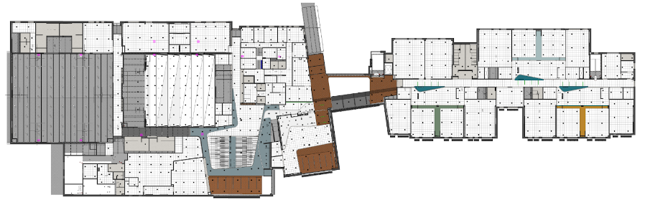
ARTICLE 5: Middle School Building Project
RECAP: 60% CD Value Management
$384,592 total estimated savings
SUMMARY OF ACCEPTED VALUE MANAGEMENT
Replaced all wood-look metal
ceilings with 2x2 acoustical tile
Replaced 57 granite bollards with
concrete/steel bollards with stainless steel sleeves
Eliminated bleachers in Gymnasium
Eliminated environmental graphics

Slide 27
ARTICLE 5. Middle School Building Project
ARTICLE 5: Middle School Building Project
Motion: As printed in the handout

