Slide 1
ARTICLE 16. Five-Year Moratorium on the Installation of Synthetic Turf on Town Land
ARTICLE 16: Synthetic Turf Moratorium
Beverley Bryant moves that the Town adopt a moratorium on the construction or installation of any synthetic turf (defined as monofilament carpet with loose infill) on any land, of any size, owned by the town, for a five-year time period starting on May 1, 2022 and ending on May 1, 2027.

Slide 2
What is Involved
ARTICLE 16: Synthetic Turf Moratorium
This moratorium is a 5-year extension of the 3-year moratorium first put in place at the 2016 Town Meeting and then extended for another 3 years in 2019.
The moratorium will apply to all town land in Concord including the Concord Public Schools. It will not apply to private land nor to the Concord-Carlisle Regional High School, which includes the Douglas-White Fields and the Stadium Field, because these fields are under joint jurisdiction with Carlisle.

Slide 3
Synthetic Turf
ARTICLE 16 : Synthetic Turf Moratorium

Slide 4
Health Concerns for Children
ARTICLE 16 : Synthetic Turf Moratorium
The crumb rubber in Concord’s synthetic turf contains known carcinogens and endocrine disrupters e.g.
Benzo(a)pyrene (highly carcinogenic – banned in Europe since 2010)
Bis(2-ethylhexyl)phthalate (endocrine disrupter) blocks androgens
Children are more susceptible to these toxic chemicals than adults, especially in low doses.
Children are repeatedly exposed to these chemicals when playing on synthetic turf.

Slide 5
Health Concerns for Children (Continued)
ARTICLE 16 : Synthetic Turf Moratorium
In 2016, three government agencies together launched the Federal Research Action Plan to study crumb rubber and its effects on human health. This study is ongoing and has not been able to show that crumb rubber is safe for our children.
Recently, more chemicals of concern have been identified in synthetic turf.

Slide 6
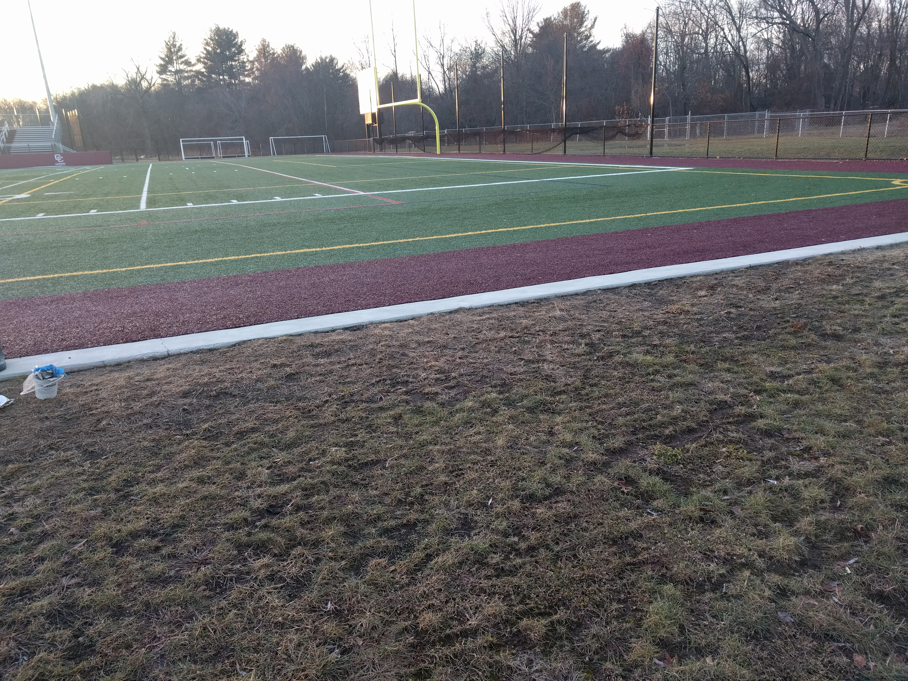
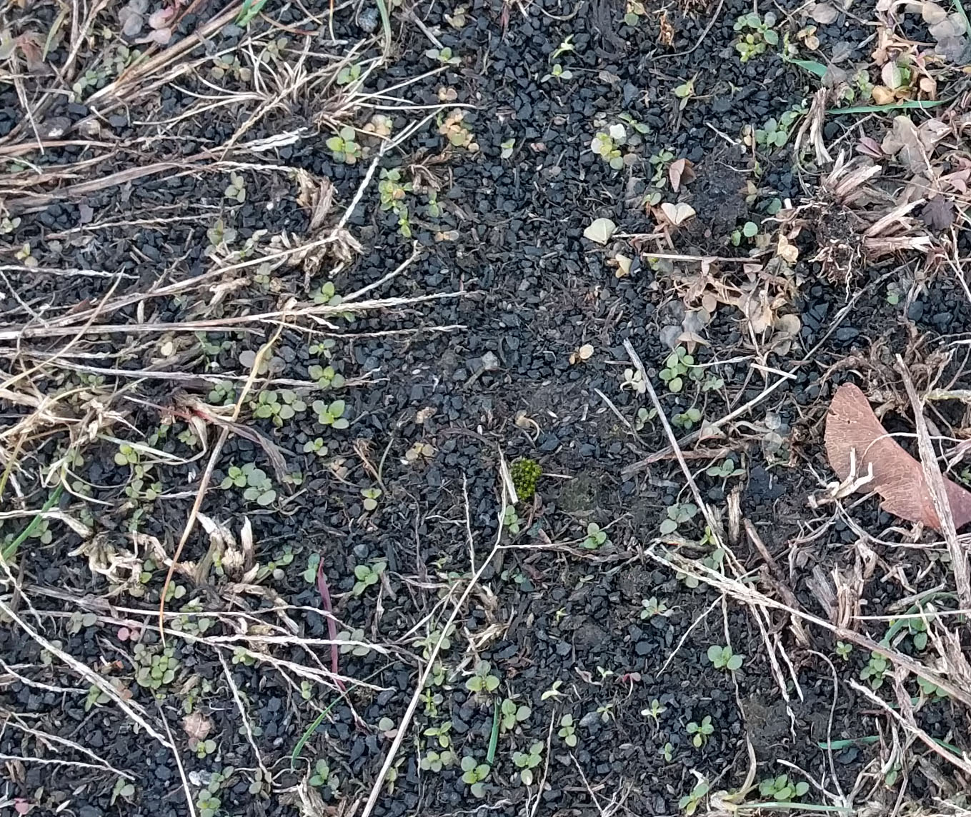
ARTICLE 16 : Synthetic Turf Moratorium
Stadium Field
3-5% of crumb rubber is lost from each field every year.

Slide 7
PFAS Pollution
ARTICLE 16: Synthetic Turf Moratorium
The plastic “grass” blades in synthetic turf are made with the aid of polyfluoroalkyl substances (PFAS).
PFAS chemicals have been found in the plastic carpets of synthetic turf and in Brockfill, made from wooden pellets.
PFAS do not degrade over time but accumulate in the environment indefinitely.
PFAS create serious health risks e.g. birth defects, cancer and immune suppression.

Slide 8
PFAS Pollution (Continued)
ARTICLE 16 : Synthetic Turf Moratorium
Massachusetts regulates measurable PFAS in drinking water to a limit of 20 ng/liter. In 2021, the Hugh Cargill well already had over half the legal limit.
The Douglas-White fields and the Stadium field are all in the Hugh Cargill well catchment area.
The addition of more synthetic turf threatens to further contaminate our water supply.

Slide 9
Plastic Pollution
ARTICLE 16 : Synthetic Turf Moratorium
As they age, the plastic “grass” blades break off, resulting in microplastics being constantly washed out of the fields.

Slide 10
ARTICLE 16 : Synthetic Turf Moratorium
Sustainability Principles
The construction of synthetic turf fields works against the sustainability principles adopted by the town in 2011:
By replacing an organic ecosystem with toxic chemicals that accumulate and pollute the soil and water;
By making these fields net emitters of carbon, rather than capturing carbon by photosynthesis;
By destroying the biodiversity that grass fields support;
By adding to the toxic waste in landfills when the fields are disposed of.

Slide 11
ARTICLE 16: Synthetic Turf Moratorium
Organically Managed Grass
New, improved grass varieties can stand up to hard use and drought conditions. They can be managed organically without pesticides and herbicides.
A U. of Missouri study showed that over 16 years, organically managed grass was far less expensive to maintain than conventional fields or synthetic turf.
Some clubs are replacing their synthetic turf with natural grass because of increased leg and foot injuries.

Slide 12
Disposal of Synthetic Turf
ARTICLE 16: Synthetic Turf Moratorium
Synthetic turf fields need to be replaced every 10-13 years and they are not currently recyclable.
Turf fields are usually disposed of out of state in a landfill.
Removal +Transportation + Landfill costs are estimated at $350,000 per field.
This is an unnecessary expense when organically managed grass is a cost-effective alternative.

Slide 13
ARTICLE 16 : Synthetic Turf Moratorium
In Conclusion
We are asking the town to continue the current moratorium on synthetic turf for another five years:
To protect our children from exposure to untested and toxic chemicals;
To allow the ongoing research on synthetic turf to be completed;
To protect our town from the toxic chemicals washing out of these fields;

Slide 14
In Conclusion (Continued)
ARTICLE 16 : Synthetic Turf Moratorium
To maintain our grass fields as a valuable ecosystem that captures carbon;
To protect the town from the increasing costs of disposal and replacement of synthetic turf fields.

Slide 15
ARTICLE 16. Five-Year Moratorium on the Installation of Synthetic Turf on Town Land
ARTICLE 16: Synthetic Turf Moratorium
Beverley Bryant moves that the Town adopt a moratorium on the construction or installation of any synthetic turf (defined as monofilament carpet with loose infill) on any land, of any size, owned by the town, for a five-year time period starting on May 1, 2022 and ending on May 1, 2027.

